Slide 1

AROUND THE PICNIC TABLE
Finance
2021
Regional Forums
Kevin Prior, CFA, CPA
Class A (nonalcoholic) Trustee
General Service Board Treasurer

Slide 2

IMPROVED AUDIT RESULTS
2020
Completed on schedule
Unqualified or “clean” audit opinion
No material weaknesses
No significant deficiencies
Only one recommendation (compared to seven last year)

Slide 3
2020 GSO FINANCIAL HIGHLIGHTS
7th Tradition of Self-Support – $10.26 million set another record, up 15.80% from $8.86 million in 2019
Cost of Services - $10.81 million down 14.9% from $12.70 million in 2019
Self-Support - covered 94.9% of cost of services compared to 69.8% in 2019
AAWS publishing gross profits – $6.58 million down 29.70% from $9.36 million in 2019, used to cover $550K shortfall between 7th Tradition Contributions and Cost of Services

Slide 4
SAVINGS ACHIEVED IN 2020
Travel, Meals, and Accommodations $1.1 M less than 2019
Total Non-Personnel savings (including travel) $1.5 M
Lockbox saves 3 Full-time Equivalents (FTEs)
Total staff savings since VRIP 5 FTEs

Slide 5
2020 GRAPEVINE FINANCIAL HIGHLIGHTS
Grapevine paid print subscriptions decreased 4.5% in 2020. Subscriptions for the online and mobile app magazine increased 7.7%
2020 Grapevine results were a gross profit of $1.231 M on the magazine and a gross profit of $354,304 on other published items. Operating expenses of $1.914 M resulted in an overall loss of $298,699 compared to a loss of $27,303 in 2019.
General Fund support of La Viña service activity was $385,771 in 2020 compared to $297,392 in 2019.
La Viña magazine circulation decreased by 36.6% in 2020 after several years of growth.

Slide 6
2021 GSO BUDGET
Total revenue $15,594,000 compared to $16,926,318 in 2020.
  Contributions $9,725,000 compared to $10,256,687 in 2020.
  Gross literature profit $5,639,400 compared to $6,582,266 in 2020.
Total operating expense $15,652,814 compared to $16,446,727 in 2020.
Operating deficit of $58,814 not including pension expenses compared to $479,571 surplus in 2020.

Slide 7
2021 GRAPEVINE BUDGET
Magazine circulation to decline slightly to 62,124 from 63,397 in 2020.
Online and e-Pub circulation to increase to 5,442 from 5,175 in 2020.
Gross profit on subscriptions $1,133,715 compared to 1,003,700 in 2020.
Grapevine net operating loss of $354,225 compared to $299,000 in 2020.
La Viña magazine circulation to decrease to 5,605 compared to 6,435 in 2020.
General Fund La Viña support of $401,970 compared to $385,771 in 2020.

Slide 8
2020 FINANCIAL HIGHLIGHTS
Amounts in $ | 2020 ACTUAL | 2020 BUDGET | COMPARED TO 2020 BUDGET | 2019 ACTUAL | COMPARED TO 2019 ACTUAL
GENERAL SERVICE OFFICE
7th Tradition Contributions | 10.26 M | 9.0 M | 1.26 M (14.0%) increase | 8.86 M | 1.40 M (15.80%) increase
Literature Gross Profit | 6.58 M | 9.8 M | 3.22 M (32.9%) decrease | 9.36 M | 2.78 M (29.70%) decrease
Net Income | (2.1) M | 1.0 K | 2.1 M decrease | (0.3) M | 1.8 M decrease
GRAPEVINE & LA VIÑA
Average Circulation | 68,572 | 67,802 | 770 increase | 71,182 | 2,610 (3.67%) decrease
Net Income (Loss) | (299 K) | 4.6 K | 303 K decrease | (27) K | 3 K (6.81%) better
General Fund support of La Viña service activity | 386 K | 317 K | 69 K increase | 297 K | 89 K (29.96%) increase
RESERVE FUND
Coverage Ratio | 7.9 months | 9.4 months | Decrease of 1.5 months (16.0%) | 9.3 Months | Decrease of 1.4 months (15.1%)
M – millions; K – thousands

Slide 9
2020 Financial Results – What Happened?
We are grateful to the fellowship for your generous response to our 7th tradition messages which increased contributions by $1.4 M compared to 2019.
The pandemic caused literature gross profit to decline by $2.78M compared to 2019.
$1.2 M in VRIP severance payments
$3.6 M in pension related expenses.
  $5.1 M VRIP pension payments for participants who elected a lump sum payment instead of payments spread over their lifespan. (paid from pension fund not general fund)
  Less $1.5M savings in the amount needed to pay expected benefits over retiree lifetimes
  Travel, meals, and accommodations decreased by $1.1 M due to the pandemic.

Slide 10


GRATITUDE
7TH TRADITION

Slide 11
7TH TRADITION – 2020 – $10.26 MILLION
24,779 GROUPS - $5,970,304
INDIVIDUALS -$4,286,383
TOTAL 7TH TRADITION $10,256,687
2ND CONSECUTIVE
RECORD 7TH TRADITON

Slide 12
IMPACT OF PANDEMIC ON 7TH TRADITION
GROUP CONTRIBUTIONS | 2020 | 2019
Amount contributed by groups | $6.0 million | $6.9 million
Number of groups contributing | 24,779 | 28,180
Percent of groups contributing | 34.8% | 40.6%
Average group contribution | $238.95 | $245.94
INDIVIDUAL CONTRIBUTIONS | 2020 | 2019
Amount contributed by individuals | $4.3 million | $1.9 million
Per capita contribution | $6.81 | $6.09

Slide 13
7TH TRADITION SELF-SUPPORT – 2010 – 2020

Slide 14
GROWTH OF ON-LINE CONTRIBUTIONS
2010 – 2020

Slide 15
2020 CONTRIBUTIONS BY REGION
/
Contribution Totals
Contributions Per Capita
Pacific United States
$548,835
$2,204,629
Northeast United States
$1,888,053
Western Canada
$9.47
$399,450
Southeast United States
$338,828
$1,579,485
Southwest United States
$808,588
Southeast United States
$9.00
$161,541
East Central United States
$155,998
$654,139
West Central United States
$75,657
$451,967
Eastern Canada
$8.28
Eastern Canada
$35,150
$428,556
Western Canada
$34,252
$268,960
Southwest United States
$7.30
Number of Contributions
Pacific United States
$6.85
Pacific United States
5,564
18,628
Northeast United States
4,346
14,683
Southeast United States
12,284
Northeast United States
$6.71
3,104
East Central United States
1,655
6,745
Southwest United States
1,460
6,541
West Central United States
$6.28
West Central United States
641
3,740
Western Canada
374
1,444
Eastern Canada
377
1,399
East Central United States
$3.82

Slide 16
COMPOSITION OF 2020 CONTRIBUTIONS
/
Online Contributions
Birthday Contributions
Other $6,390 (1%)
Other $345,282 (20%)
Group $110,056 (26%)
Individual $733,306 (42%)
Group $687,208 (39%)
Individual $309,980 (73%)
Total: $1,765,795
Total: $426,426
All Contributions Distributed by Dollar Value
43,543
18,900
6,783
4,599
2,646 _{1,937} |  |  | 783 |  | 1,001 |  | 458 |  | 979 |  | 227 |  | 340 |  | 141 |  | 123 |  | 136 |  | 149 |  | 60 |  | 85 |  | 54 |  | 355 |  | 705
$0 - $50 | $50 - | $100 - | $150 - $200 - $250 - $300 - |  | $350 - |  | $400 - |  | $450 - |  | $500 - |  | $550 - |  | $600 - |  | $650 - |  | $700 - |  | $750 - |  | $800 - |  | $850 - |  | $900 - |  | $950 - |  | More
 | $100 | $150 | $200 $250 $300 $350 |  | $400 |  | $450 |  | $500 |  | $550 |  | $600 |  | $650 |  | $700 |  | $750 |  | $800 |  | $850 |  | $900 |  | $950 |  | $1,000 |  | than $1,000

Slide 17
CHALLENGE CONTRIBUTIONS

Slide 18

THROUGH OUR OWN SELF-SUPPORT

Slide 19

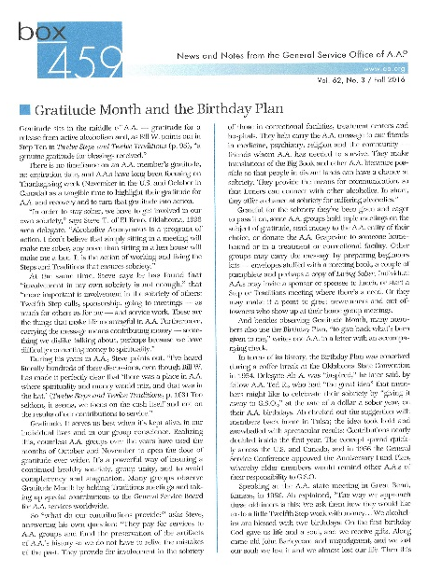




G.S.O.’s TWO BASIC FUNCTIONS
Publishing
Services on Behalf of the G.S.B.
Group Records

Slide 20
AAWS – PUBLISHING – 2020 ACTUAL VS 2020 BUDGET
$ in Thousands | 2020 ACTUAL | 2020 BUDGET | INCREASE (DECREASE)
Gross Sales – Literature | 9,098 | 14,750 | (5,652)
Discounts | (275) | (200) | 75
Net Sales - Literature | 8,823 | 14,550 | (5,727)
Cost of Literature Sold - Printing | 1,609 | 2,750 | (1,141)
Direct Shipping and Warehousing | 633 | 2,000 | (1,367)
Gross Profit | 6,582 | 9,800 | (3,218)
Gross Profit Percentage | 72.3% | 67.4% | 4.9%

Slide 21
GRAPEVINE – 2020 ACTUAL VS 2020 BUDGET
AVERAGE CIRCULATION – PRINT | 63,397
ONLINE & APP | 5,175
 | 2020 ACTUAL | 2020 BUDGET | Increase (Decrease)
Magazine Revenue | $1,874 | $1,983 | ($119)
Magazine Direct Costs | ($643) | ($773) | ($130)
Gross Profit on Magazine | $1,231 | $1,210 | ($12)
Other Publishing Revenue | $582 | $1,103 | ($522)
Cost of Goods Sold | ($227) | ($314) | ($86)
Gross Profit on Other Publishing Items | $354 | $790 | ($436)
Total Gross Profit | $1,585 | $1,999 | ($424)
Costs and Expenses
Editorial Costs | $870 | $769 | $101
Circulation and Business | $961 | $1,066 | ($105)
General and Administrative | $84 | $190 | ($106)
Total Costs and Expenses | $1,915 | $2,025 | ($110)
Interest Income | $30 | $30
Net Income | ($299) | $4 | ($303)

Slide 22
GRAPEVINE OPERATING RESULTS – 2007 – 2020

Slide 23
RECURRING OPERATING EXPENSES – 2020 – $16.6 M
FINANCIAL STATEMENT EXPENSE CATEGORIES
PERCENTAGE BREAKDOWN

Slide 24
FELLOWSHIP SERVICES – DIRECT COSTS & PERCENTAGES
$ in Thousands | 2020 | % of Total | 2019 | % of Total | 2018 | % of Total
Public Information | 478 | 4.1 | 327 | 2.9 | 336 | 2.9
Cooperation with Professional Community | 334 | 3.1 | 292 | 2.6 | 297 | 2.6
Treatment Facilities | 191 | 1.8 | 132 | 1.2 | 131 | 1.1
Corrections | 441 | 4.1 | 294 | 2.6 | 329 | 2.9
Overseas Services (Literature Assistance) & Loners | 791 | 7.3 | 526 | 4.6 | 501 | 4.4
Regional Forums | 461 | 4.3 | 532 | 4.7 | 453 | 4.0
Archives | 1,221 | 11.3 | 800 | 7.0 | 791 | 6.9
Spanish Services | 10 | 0.1 | 27 | 0.1 | 0 | 0
Communications | 326 | 3.0 | 189 | 1.6 | 0 | 0
Sub-Total – Outreach | 4,252 | 39.3 | 3,109 | 25.4 | 2,838 | 24.8
General Service Conference | 573 | 5.63 | 1,114 | 9.5 | 1,092 | 9.6
Trustees & Directors Activities | 104 | 1. | 577 | 4.9 | 601 | 5.2
Nominating | 428 | 4.0 | 259 | 2.2 | 269 | 2.3
International Convention | 309 | 2.9 | 190 | 1.6 | - | -
World Service Meeting | 208 | 1.9 | 203 | 1.8 | 203 | 1.8
Sub –Total – Service Leadership | 1,622 | 15.0 | 2,164 | 18.3 | 2,165 | 18.9
Group Services | 2,873 | 26.6 | 2,202 | 18.7 | 2,235 | 19.6
Supporting Services (Technology, Finance, etc.) | 2,062 | 19.1 | 4,329 | 37.9 | 4,189 | 36.7
Total Costs of Services Provided | 10,810 | 100 | 11,804 | 100.0 | 11,427 | 100.0
$ increase over prior year – % increase over prior year | -994 | -1.09 | 377 | 3.3 | 1,205 | 11.8%
La Viña Service Activity - NOTE – GSB support for the La Viña service activity is NOT an actual operating expense of GSO, but is included here to show its relative significance of this service. | 386 | n/a | 297 | n/a | 148 | n/a

Slide 26
OUTREACH SERVICES PROVIDED TO FELLOWSHIP 2020

Slide 27
2020 SERVICE LEADERSHIP Activities

Slide 28
MEMBER SERVICES & STATISTICS 2020
2020
Number of Members | 1,473,390
Cost of Services per Member | 7.34
7th Tradition Self-Support Contributions per Member | 6. 81
Cost of Services NOT covered by Self-Support | .53
Number of Groups | 71,190
Cost of Services per Group | $151.85
7th Tradition Self-Support Contributions per Group | 144.12
Cost of Services NOT covered by Self-Support | 7.73
Percentage of Groups Contributing | 34.8%
Number of Groups that Contributed | 24,779
7th Tradition Self-Support of Groups that contributed | $238.95

Slide 29
2020 PRUDENT RESERVE
Beginning Balance January 1, 2020 | 16,204,773
Investment Earnings | 245,191
Drawdowns | 4,000,000
Ending Balance December 31, 2020 | 12,449,964
Composition of Ending Balance
Cash | 1,063,149
Certificates of Deposit (CDARs) | 12,610,224
Accrued Interest | 250,091
Less Grapevine subscription liability | (1,473,500)
Ending Balance | 12,449,964
Number of Months Expenses Held
January 1, 2020 | 9.27
December 31, 2020 | 7.90
Target | 9 to 12

Slide 30
2020 PRUDENT RESERVE
Several long term projects were moving toward completion, including the Voluntary Retirement Incentive Program, the completion of the 8th floor, Netsuite Implementation and the work on the new website.
In addition we needed the cash to refund registration fees and pay vendors for the International Convention prior to receiving the insurance settlement.
Notes:
.

Slide 31
USES OF GSB’s RESERVE FUND
Concept of GSB’s Prudent Reserve – not same as in your Home Group’s reserve
GSB’s Reserve Fund covers much more
  Operating shortfalls between revenues and expenses
  Capital construction projects
  Lease guarantees
  Pension obligations
  Retirement medical obligations
  Litigations and legal liabilities
  Any other unknowns

Slide 32
RESERVE FUND
Cut Costs
In 2020 expenses were reduced by 1.5M in non personnel cost
Increase 7th Tradition Support
Continue to let the fellowship know what is happening at GSO and show how the work to carry the message continues
Increase the Reserve
Develop a plan to insure the reserve fund is adequately funded for future needs
Find more innovative ways to keep costs down

Slide 33
2020 INTERNATIONAL CONVENTION - CANCELLED
 | Detroit 2020 Budget | Detroit 2020 Actual
Attendees | 47,500 | 0
Registration Revenue | 5,583,218 | 0
Cancellation Donations |  | 40,324
Insurance Payment – Net of $180,000 shared with Grapevine |  | 1,972,134
Total revenue | 5,583,218 | 2,012,458
Stadium | 1,446,571
Convention Center | 1,267,830
Busing |  | 70,500
All other | 2,804,119 | 2,152,581
Total costs | 5,518,520 | 2,223,081
Net | 64,698 | (210,624)

Slide 34
8TH FLOOR CONSTRUCTION

Slide 35
ERP ACTUAL VS BUDGET
PROJECT PHASE | BUDGET | ACTUAL THRU 12/31/20 | VARIANCE
Software Selection and Design Consultant | 172,217 | 146,456 | 25,761
Initial Implementation Vendor | 256,933 | 840,786 | (583,853)
Program & Project Management Consultant | 670,421 | 649,885 | 20,536
Reimplementation & Ongoing Support Vendor | 598,710 | 560,558 | 38,152
TOTAL | 1,698,281 | 2,197,685 | (499,404)

Slide 36
BENEFITS OF ERP
ENTERPRISE RESOURCE PLANNING SYSTEM
Bringing all our data together
More information reported more accurately more timely reporting
More efficient member service
Literature sales and contributions websites
Fellowship Connection
New technology to secure data and prevent breaches

Slide 37


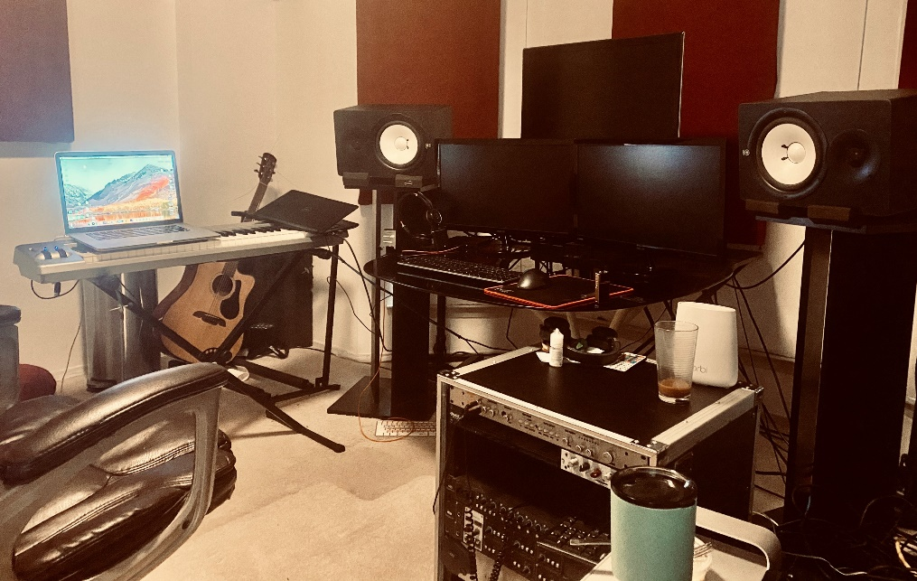
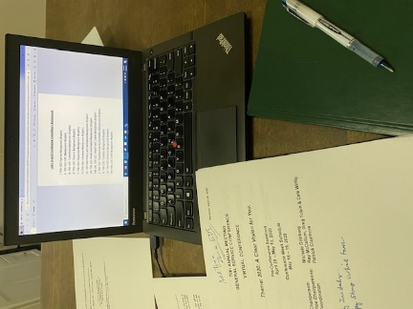

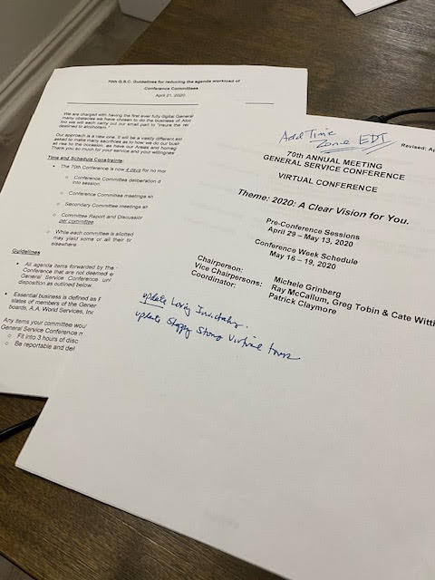
2020 COVID-19 IMPACT
Services continue at AAWS and Grapevine
Over 125,000
Alcoholics provided with digital Grapevine subscriptions free of charge
1,800
Pieces of inmate correspondence 1,200 members behind the walls connected to members outside
March 2020
December 2020
More than 90,000
emails/phone calls answered requesting information or help from GSO, since the office physically closed on March 20.
One
Completely virtual General Service Conference designed from the kitchens, living rooms and home offices across the US and Canada

Slide 38
IMPACT OF PANDEMIC ON REVENUE DISTRIBUTION

Slide 39
BEFORE AND AFTER PANDEMIC
Monthly average REVENUE AND EXPENSE

Slide 40
2020 UPDATE COVID-19 IMPACT
Key talking points for the fellowship
1 | 2 | 3
A.A. is still here! We actually thrive in uncertainty– hope remains, and the message continues to be carried | Our prudent reserve is designed precisely for this situation and will carry us through until the membership can get us back on our feet | This remains an unprecedented time in the world and a pivotal moment for A.A. Now is the time for our membership to continue to demonstrate what self-supporting really means

Slide 41
THANK YOU
Paul Konigstein, CFO
Zenny Medina, Director of Finance
Patrick C, Conference Coordinator, for his patience
All of employees of both A.A.W.S. and Grapevine
Members of Trustees’ Finance and Budgetary Committee, along members of the Finance Committees of A.A.W.S. and Grapevine
Our Independent Auditors – Marks Paneth, LLP
Our outsourced accounting support – Your Part-time Controller
************
Any questions – Please feel free to contact me at – kevin@kevinjprior.com

