Slide 1
The 72nd Annual General Service Conference
A.A. Comes of Age 2.0
Unified in Love and Service
April 24-30, 2022
New York Marriot @ the Brooklyn Bridge
Brooklyn, New York

Slide 2
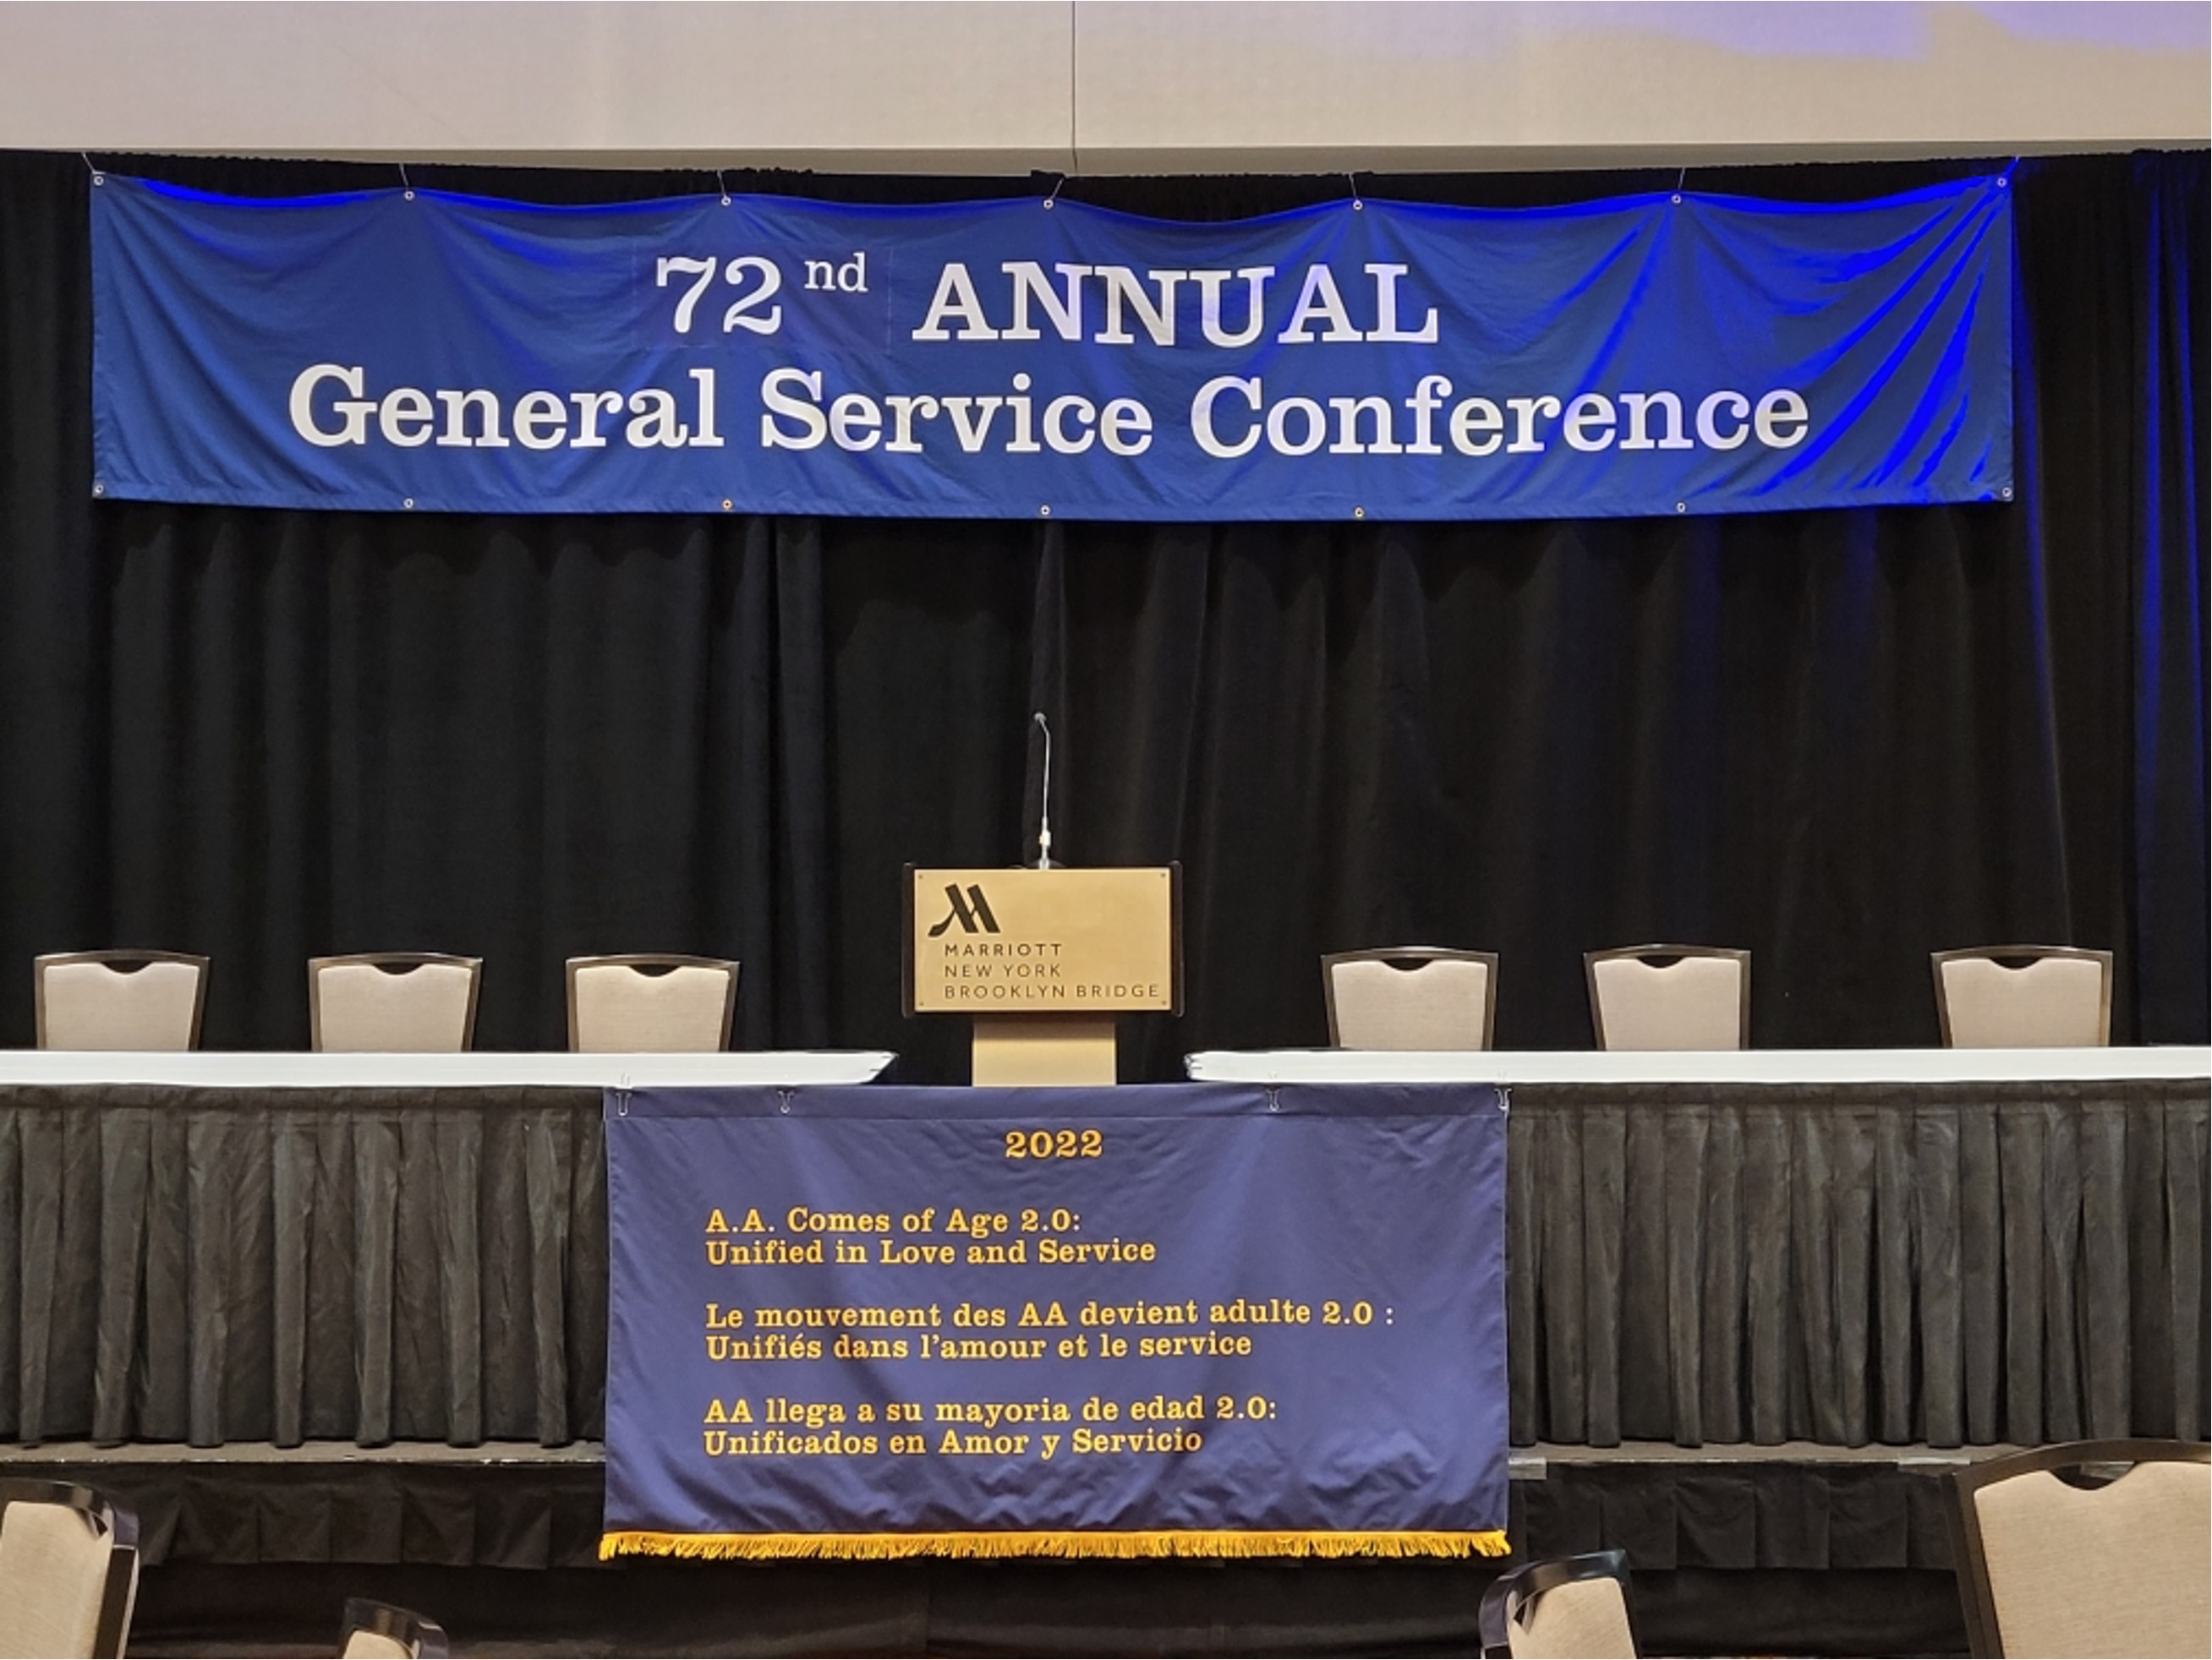

Slide 3
The 72nd Annual General Service Conference
Saturday April 23, 2022
Preconference Day
Hospitality for Conference Members & Guests
1728 Meeting (12x12x12) - Autonomy Refuse to be dominated
Remote Communities – Unity cannot occur when exclusion is present
”Delegates Only” Meeting -

Slide 4
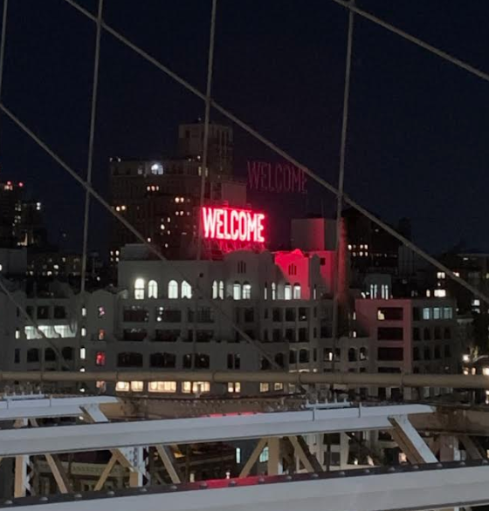

Slide 5
The 72nd Annual General Service Conference
Sunday April 24, 2022
Registration
Opening Session-Welcome, Opening, Admissions, Roll Call, Greetings, Overview of Agenda/Manual
Keynote Address: Kathi Fowler, Pacific Regional Trustee

Slide 6
The 72nd Annual General Service Conference
FishBowl Your Third Legacy Workshop
Regional Luncheon/Delegate Orientation
Mechanics of the Conference
Presentations/Discussion:
A.A. International/World Service Meeting
REDELA (Meeting of the Americas) by
Marita R, TAL-US
A.A. Around the World by
Trish L, TAL-Canada

Slide 7
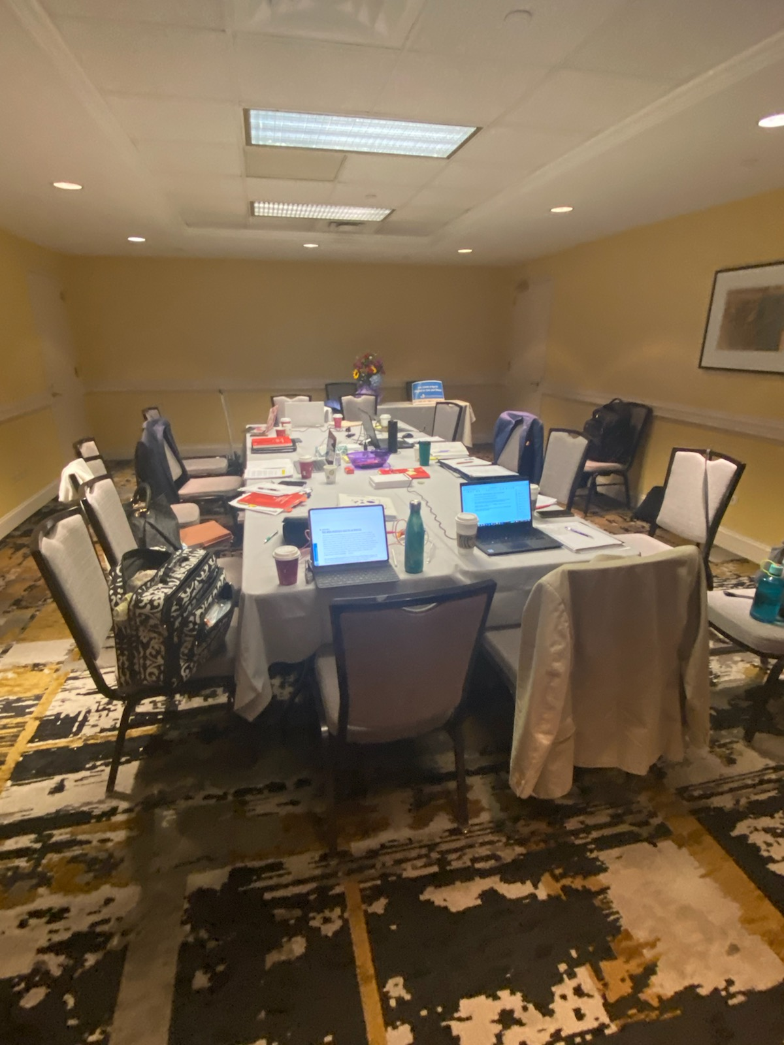
The 72nd Annual General Service Conference
Joint Trustees and Conference Committee Meetings:
Equitable Distribution of Workload Items
Report and Charter Committee

Slide 8
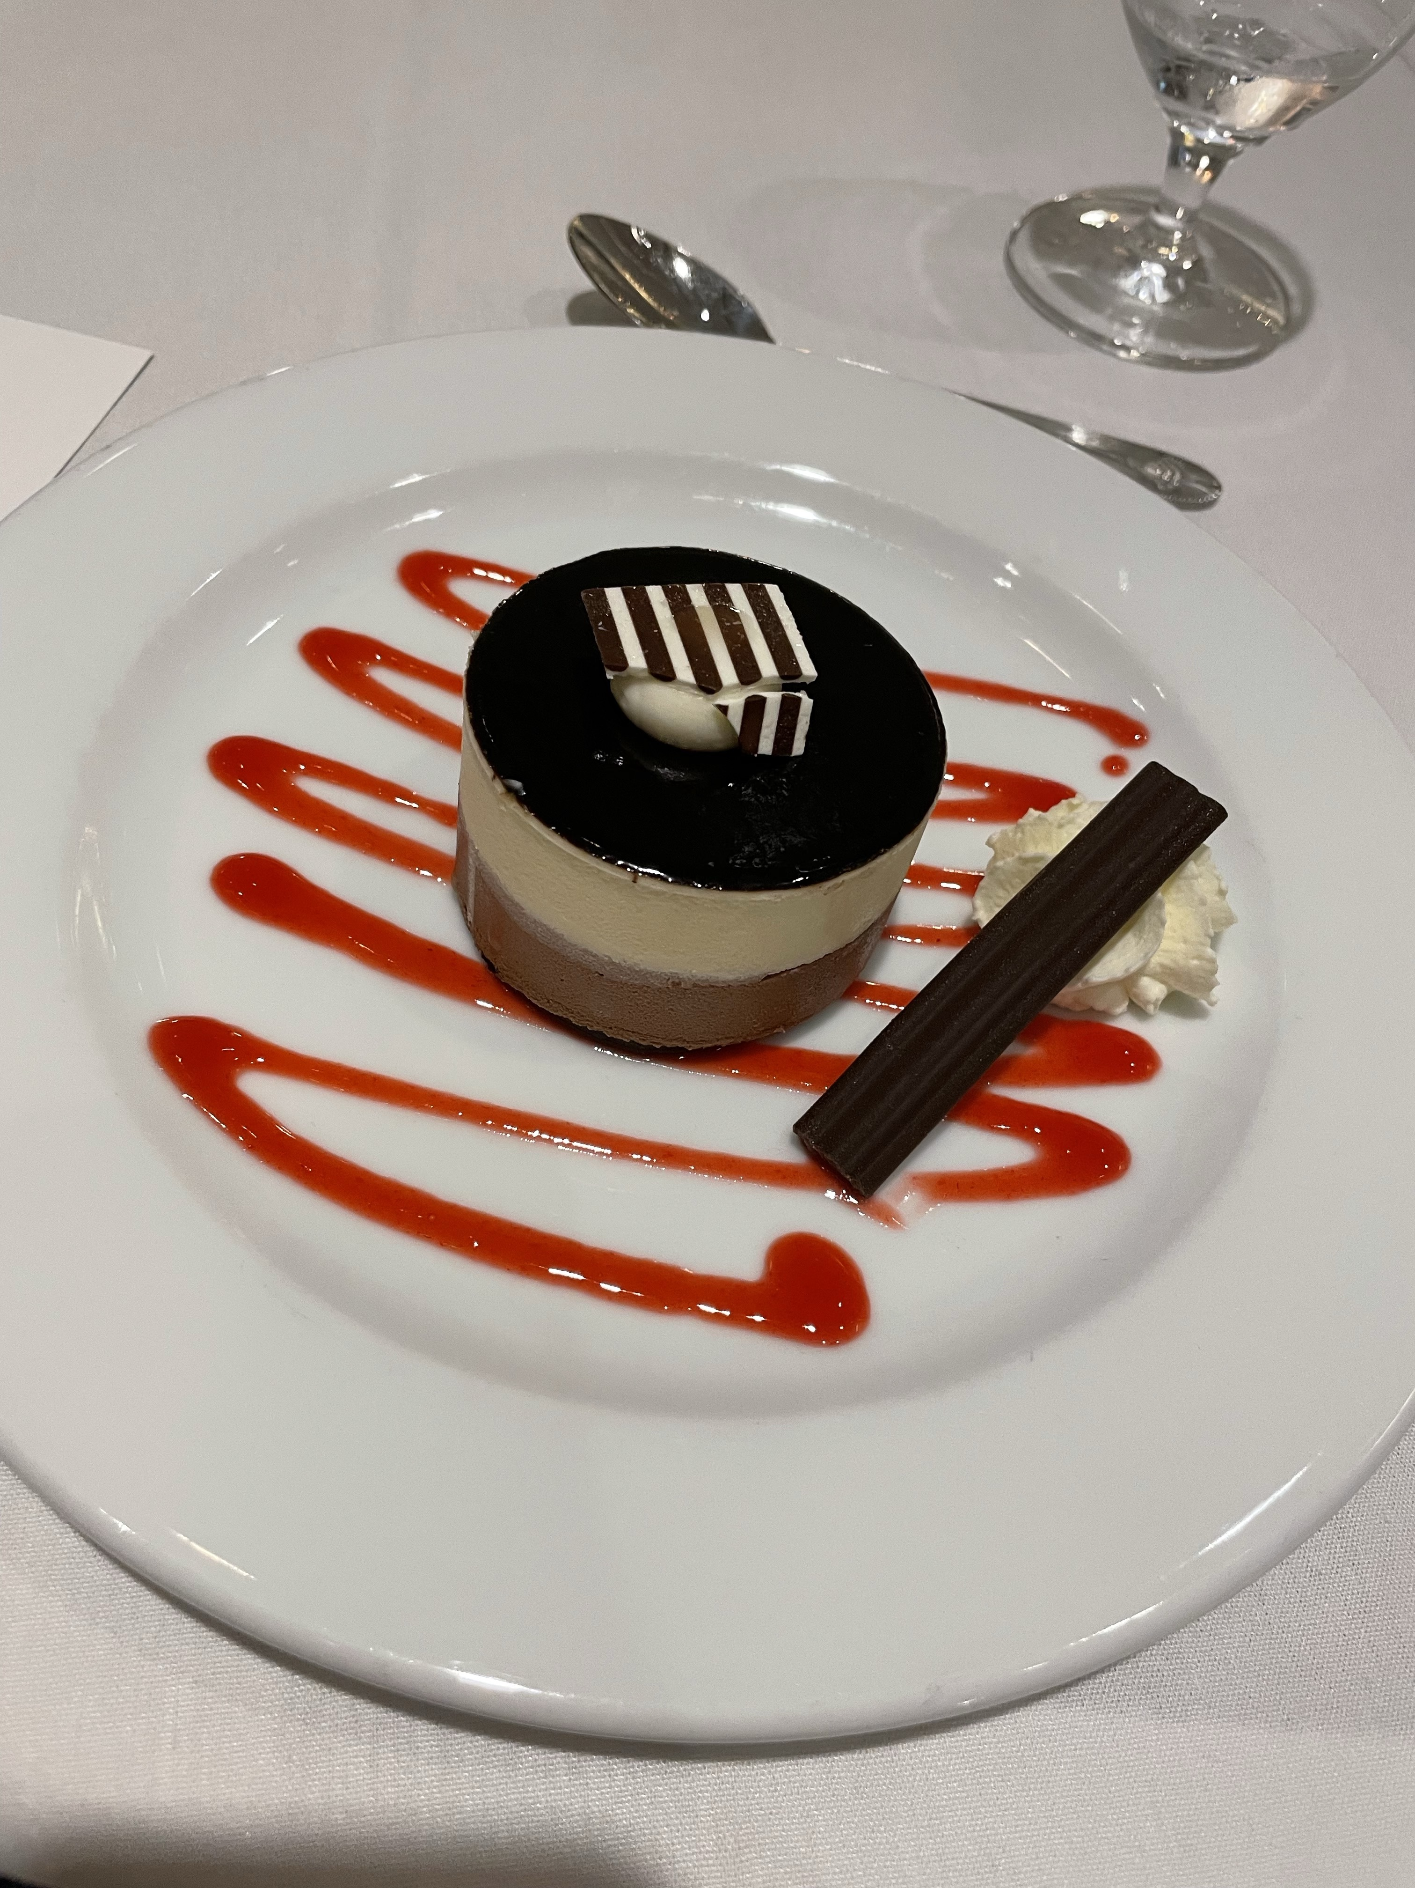
The 72nd Annual General Service Conference
Sunday Evening Session:
Opening Dinner
A.A. Meeting

Slide 9
The 72nd Annual General Service Conference
Monday April 25, 2022
Serenity Meeting –
“We may not need a General Service Conference to ensure our own recovery. We do need it to ensure the recovery of the alcoholic who still stumbles in the darkness one short block from this room....”
Why Do We Need a Conference The AA Service Manual, p. 40
Morning Session:
Conference Committee Meetings
Afternoon Session:
General Service Board Report Summary
A.A.W.S. Board Report Summary
AA Grapevine Board Report Summary

Slide 10
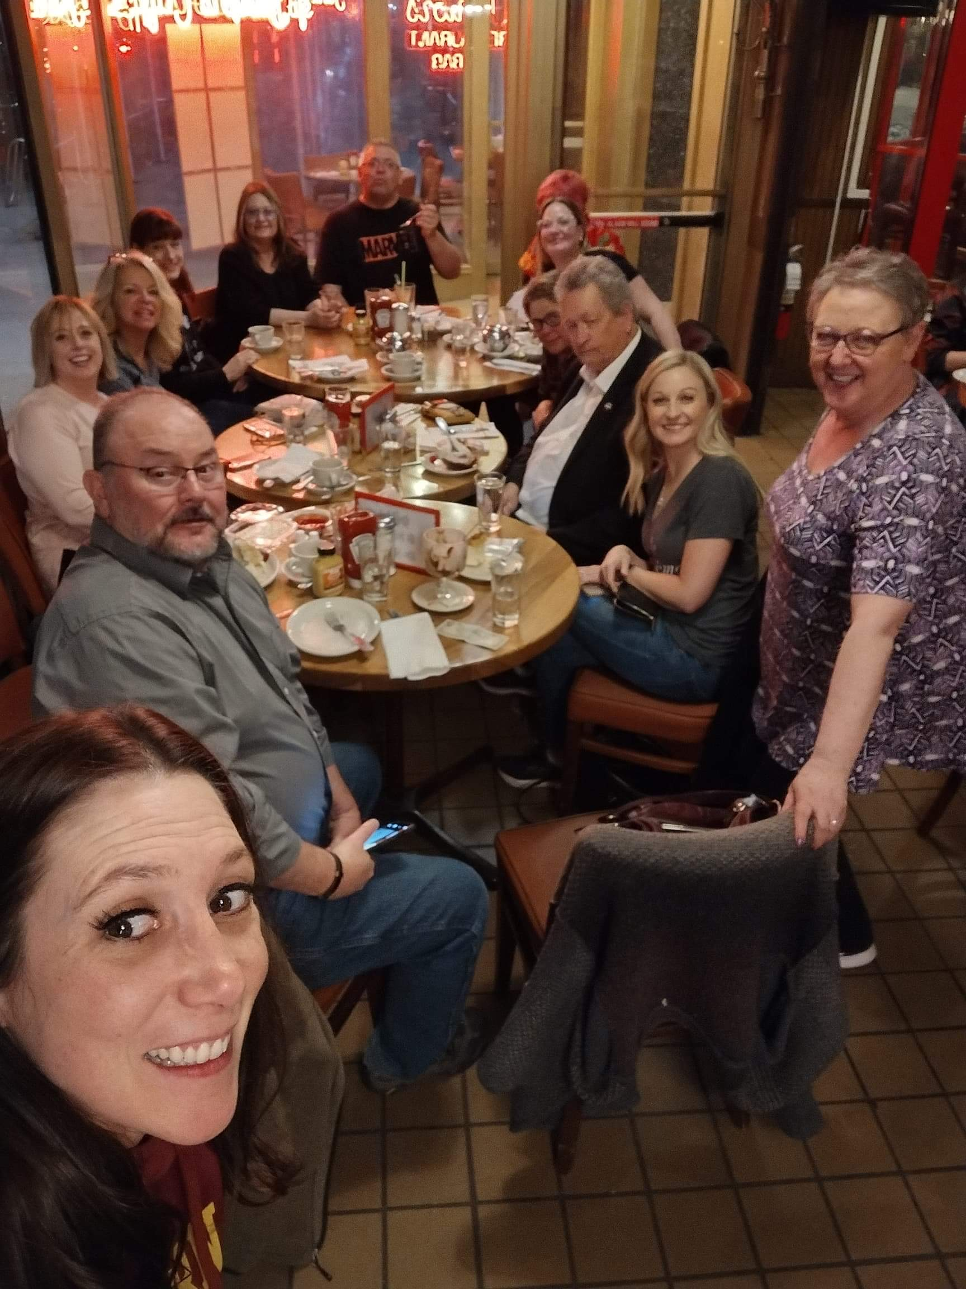
The 72nd Annual General Service Conference
Evening Session:
Finance Report
General Sharing Session – What’s on Your Mind
Juniors!!

Slide 11
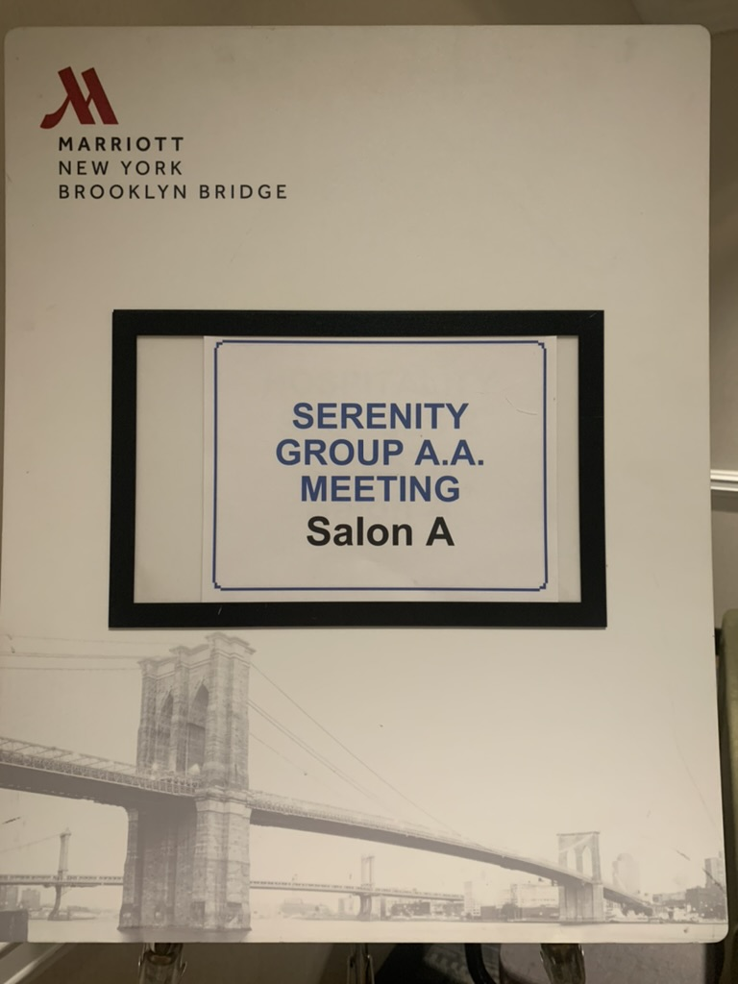
The 72nd Annual General Service Conference
Tuesday April 26, 2022
Serenity Meeting -
“So fear need not always be destructive, because the lessons of its consequences can lead us to positive values.”
As Bill Sees It, p. 22
Morning Session:
Conference Committee Meetings

Slide 12
The 72nd Annual General Service Conference
Afternoon Session:
Presentations/Discussion
How do A.A.’s go to any length to Recover, Unify, & Serve
Going Beyond Fear
How to Reach Anyone, Anywhere
Special Board Presentation:
Participation of Online Groups in the US/Canada Service Structure
Workshop:
The Warranties–Our Promise to the Fellowship and the World

Slide 13
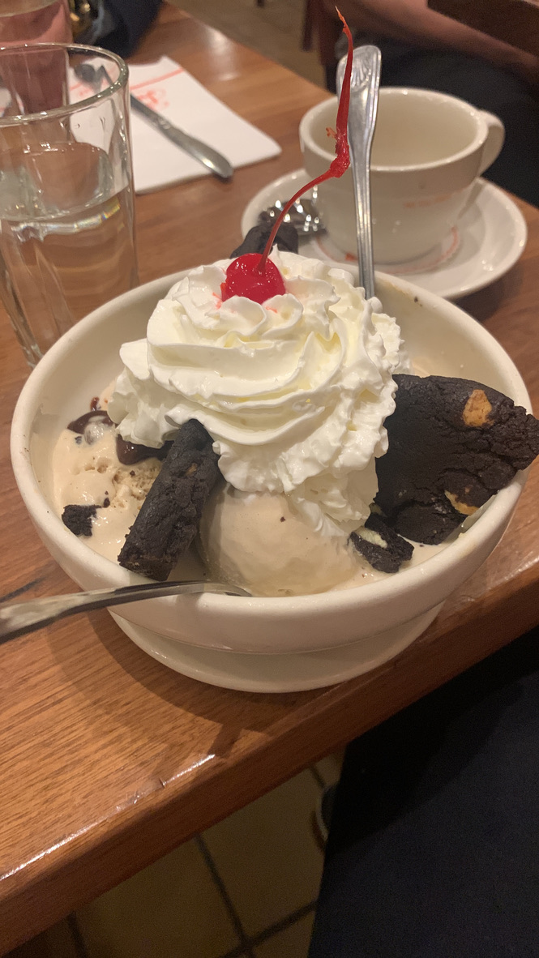
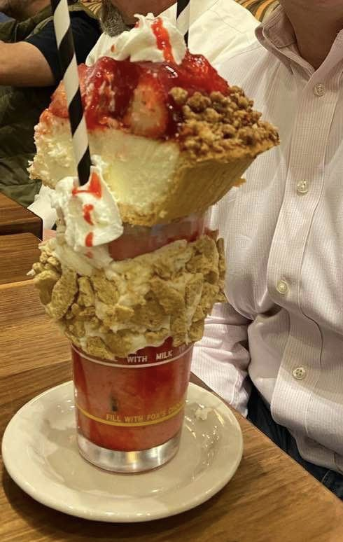
The 72nd Annual General Service Conference
Evening Session:
Delegates Dinner and Delegates Only Meeting
Trustees Dinner

Slide 14
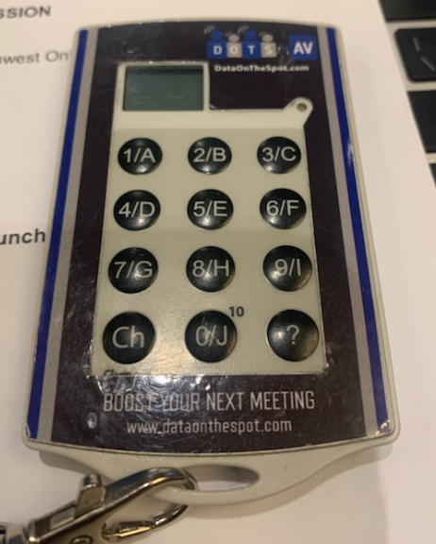
The 72nd Annual General Service Conference
Wednesday April 27, 2022
Serenity Meeting –
“When I am disturbed, it is because I find some person, place, thing, or situation—some fact of life—
unacceptable to me, and I can find no serenity until I accept that person, place, thing, or situation as being exactly the way it is supposed to be at this moment.”
Alcoholics Anonymous, p. 417
Morning Session:
Committee Reports & Discussion
Regional Luncheons for Delegates

Slide 15
The 72nd Annual General Service Conference
Afternoon Session:
Elections
72nd GSC Elected Eastern Canada Trustee –
Joyce S. A83 Eastern Ontario
72nd GSC Elected Pacific Regional Trustee –
Reilly K. A58 Oregon

Slide 16
The 72nd Annual General Service Conference
Brandon from DOTS:
“ALL THAT and then the HAT???”

Slide 17
The 72nd Annual General Service Conference
Afternoon Session Continued & Evening Session:
Committee Reports and Discussion
General Sharing Session: “What’s on Your Mind?”

Slide 18
The 72nd Annual General Service Conference
Thursday April 28, 2022
Serenity Meeting -
“Compromise comes hard to us all-or-nothing drunks. Nevertheless, we must never lose sight of the fact that progress is nearly always characterized by a series of improving compromises.”
The AA Service Manual, p. 37
Committee Reports and Discussion
General Sharing Session – What’s On Your Mind
Committee Reports and Discussion
Microphone Titles:
P B & J

Slide 19
The 72nd Annual General Service Conference
Friday April 29, 2022
Serenity Meeting-
“Practically every A.A. member declares that no satisfaction has been deeper and no joy greater than in a
Twelfth Step job well done.”
Twelve Steps and Twelve Traditions, p.110
Committee Reports and Discussion
Presentation Discussion:
“Publishing Highlights: Innovations in attraction, inclusion and accessibility”
Afternoon Session:
Committee Reports – Floor Actions and Discussion

Slide 20
The 72nd Annual General Service Conference
Evening Session:
Floor Actions and Discussion Continued
Final Sharing Session
Farewells by Rotating Delegates
Closing Remarks – Linda Chezem GSB Chair
Closing with Serenity Prayer
In English, French, and Spanish

Slide 21
The 72nd Annual General Service Conference
Saturday April 30th, 2022
Closing Brunch
Farewell Talks by Rotating Trustees (5)

Slide 22
The 72nd Annual General Service Conference

Slide 23
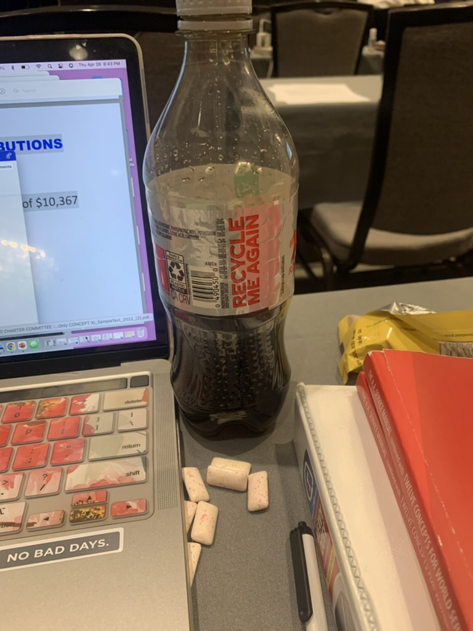
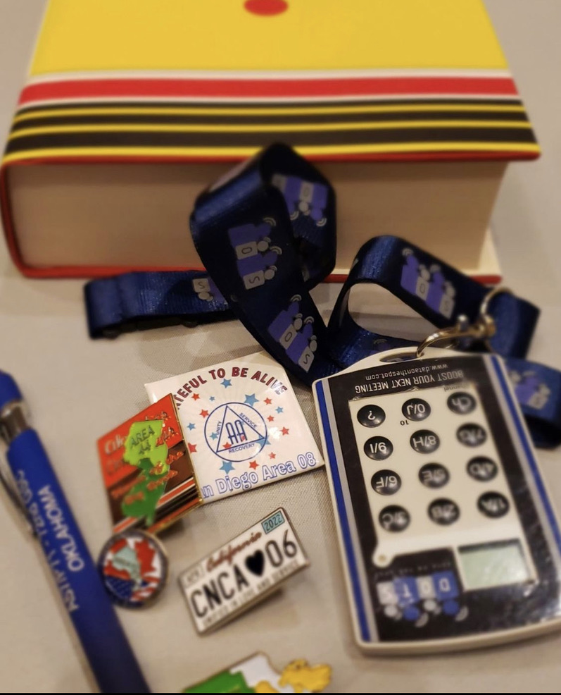
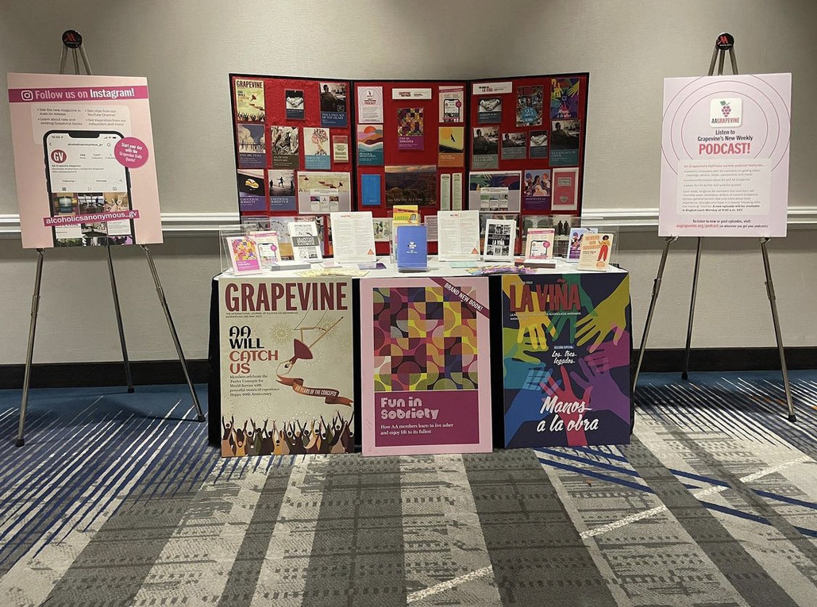
The 72nd Annual General Service Conference

Slide 24
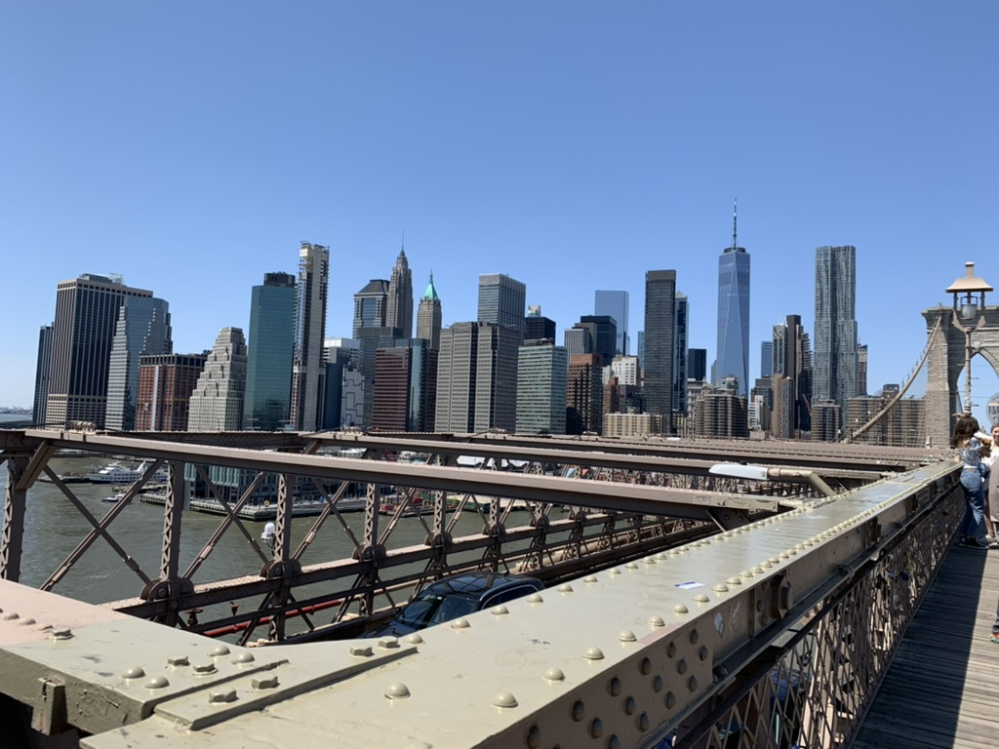
The 72nd Annual General Service Conference

Slide 25
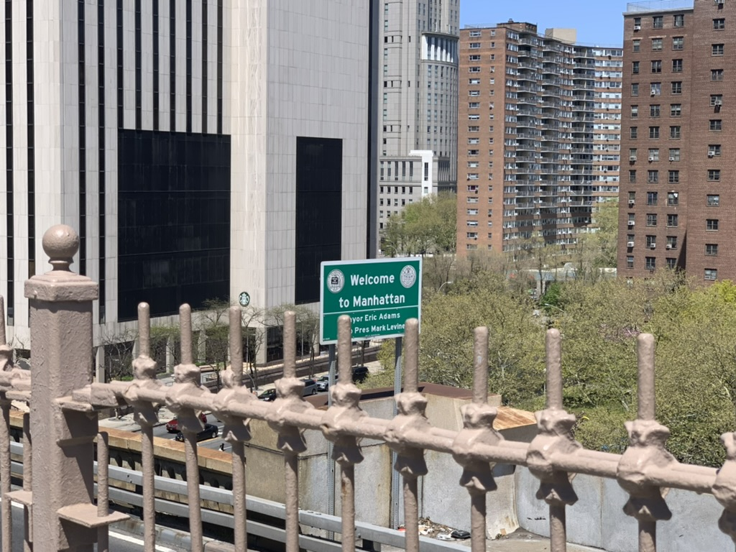
The 72nd Annual General Service Conference

Slide 26
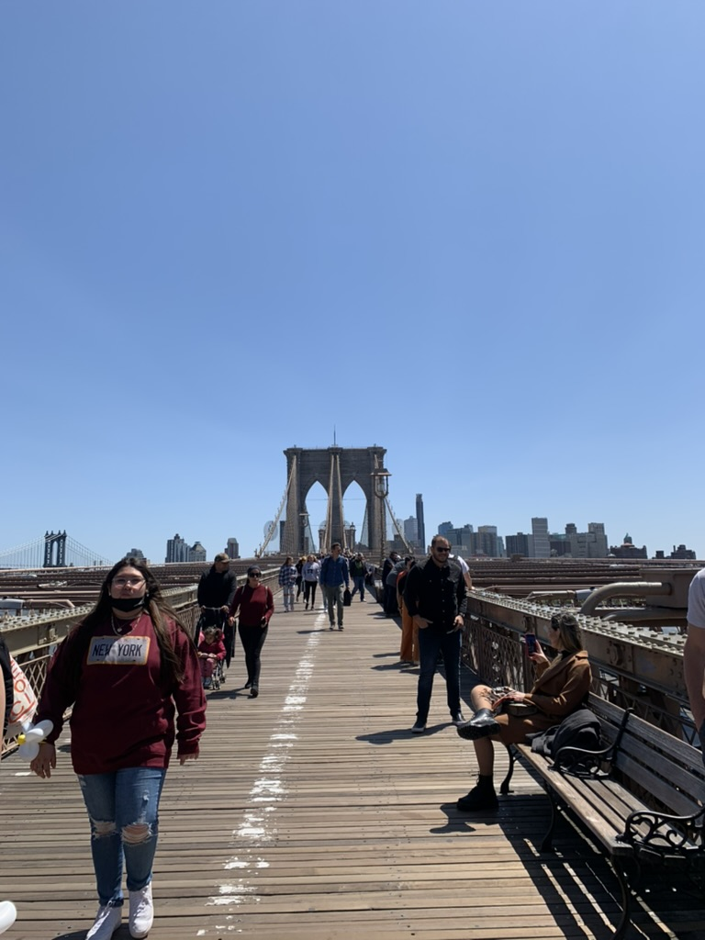
The 72nd Annual General Service Conference

Slide 27
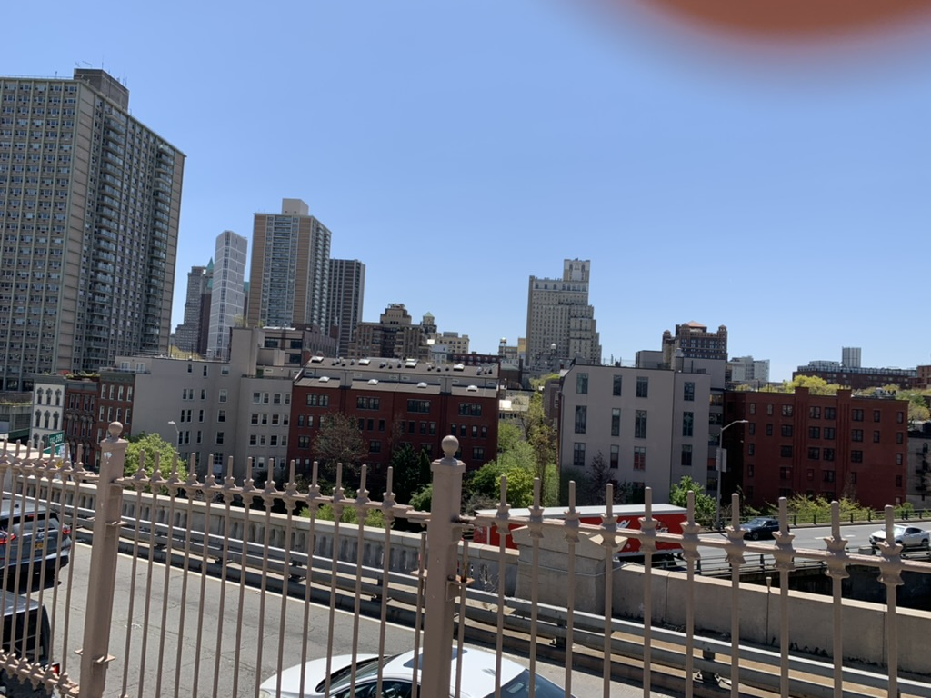
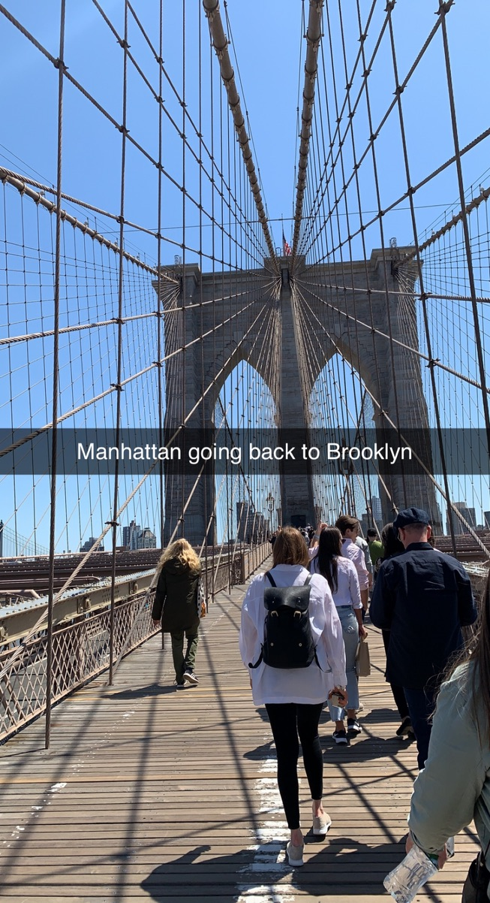
The 72nd Annual General Service Conference

Slide 28
The 72nd Annual General Service Conference

Slide 29
The 72nd Annual General Service Conference
Floor Actions and Committee Recommendations Resulting in Advisory Actions

Slide 30
The 72nd Annual General Service Conference
Floor Actions:
It was recommended that:
1. The trustees’ Committee on Literature continue to make edits to the draft pamphlet “The Twelve Steps Illustrated” with a new draft or progress report to be brought back to the 2023 Conference Committee on Literature, keeping in mind: color, diverse expressions of spirituality and accessible interpretation of meaning in the illustrations.
Passed 108/11 SU 80

Slide 31
The 72nd Annual General Service Conference
Floor Actions Continued:
2. The 2022 Membership Survey questionnaire receive final editorial review by the trustees’ Public Information Committee after consulting with our professional survey methodologist, to address concerns raised by the 72nd General Service Conference related to the survey questions about Racial and Ethnic Background and Employment Status.
Passed: 107/9 SU: 77

Slide 32
The 72nd Annual General Service Conference
Committee Recommendations:
Agenda:
It was recommended that:
3. The theme for the 2023 General Service Conference be:
“A.A.’s Three Legacies-Our Common Solution”
Passed: 129/0 Unanimous

Slide 33
The 72nd Annual General Service Conference
Agenda Continued:
4. The presentation theme and topics for the 2023 GSC be:
Presentation Theme:
“General Service–Our Mighty Purpose and Rhythm”
Presentation Topics:
”Our Common Perils and Common Solution”
“Using A.A.’s Literature in Carrying the Message”
“Fostering a Thriving Three Legacy Culture”
Passed: 122/3 SU: 83

Slide 34
The 72nd Annual General Service Conference
Agenda Continued:
5. The workshop topic for the 2023 General Service Conference be:
“Practicing Our Twelve Traditions Across All Group Settings”
6. The General Service Board develop a status report on the progress and outcomes from the 2013-15 Conference inventory and include a draft plan for another Conference inventory with considerations of its value, timeline and approach to be brought back to the 2023 Conference Committee on Agenda.
Passed: 125/1 SU:85
Passed: 120/11 SU: 88

Slide 35
The 72nd Annual General Service Conference
Archives: No Recommendations
Cooperation with the Professional Community:
No Recommendations
Corrections: No Recommendations
Finance: No Recommendations
Grapevine and La Vina: No Recommendations
International Conventions/Regional Forums:
No Recommendations

Slide 36
The 72nd Annual General Service Conference
Literature: It was recommended that:
The pamphlet “Questions and Answers on Sponsorship” be revised to add the following text regarding safety in A.A.:
In the section “For the person wanting to be a sponsor” (p 14) under the heading “What does a sponsor do and not do?”:
Stresses the importance of A.A. being a safe place for all members and encourages members to become familiar with service material available from
General Service Office such as “Safety in A.A.-Our Common Welfare.”

Slide 37
The 72nd Annual General Service Conference
Literature Continued:
In the section “for groups planning sponsorship activity” (p23), under the heading, “How does sponsorship help a group?” add a fourth paragraph:
Sponsorship can also help a group to create a welcoming and secure environment. Safety is an issue affecting all members and it is important for groups to remain accessible to all who are seeking recovery. Sponsorship can help keep the group focused on the common welfare.
Passed – Reconsider - Amended – Recommit – Amended - Passed: 101/28 SU: 86

Slide 38
The 72nd Annual General Service Conference
Literature Continued:
The booklet LIVING SOBER be revised to add the following paragraph regarding safety and A.A. in chapter 29 page 76:
“Of course, A.A. is a reflection of the larger society around us and problems found in the outside world can also make their way into the rooms of A.A. But by keeping the focus on our common welfare and primary purpose, groups can help provide a safe and secure environment for all their members.”
Passed: 114/6 SU: 80

Slide 39
The 72nd Annual General Service Conference
Literature Continued:
9. The video animation of the pamphlet “The Twelve Concepts Illustrated” (currently published by the General Service Board of A.A. Great Britain) be adapted and produced by the Publishing Department. The committee requested a progress report or rough cut be brought back to the 2023 Conference Committee on Literature
Amended – Passed: 121/10 SU: 88

Slide 40
The 72nd Annual General Service Conference
Literature Continued:
10. The draft of the pamphlet “Young People and A.A.” be approved.
11. The pamphlet “Twelve Traditions Illustrated” be updated with non-offensive, contemporary text and illustrations and that a progress report or draft pamphlet be brought back to the 2023 Conference Committee on Literature.
Recommit – Passed: 111/17 SU: 86
Amended – Passed: 101/31 SU 88

Slide 41
The 72nd Annual General Service Conference
Literature Continued:
The updated pamphlet “Is A.A. for You?” be approved.
The updated pamphlet “Is There an Alcoholic in Your Life?” be approved.
The updated pamphlet “Frequently Asked Questions About A.A.” be approved.
The updated pamphlet “This is A.A.” be approved.
Passed 122/6 SU: 86
Passed 122/6 SU: 86
Passed 120/6
SU: 84
Passed 123/5 SU: 86

Slide 42
The 72nd Annual General Service Conference
Policy/Admissions: It was recommended that:
Rio D., alternate delegate, Area 79 British Columbia/Yukon Territory, be seated as a Conference member at the 72nd General Service Conference because Bob K., Panel 71 delegate for Area 79 is unable to attend.
Christopher M., alternate delegate, Area 47 Central New York, be seated as a Conference member at the 72nd General Service Conference because Todd D., Panel 71 delegate for Area 47 is unable to attend.
Both Passed 100% Unanimity

Slide 43
The 72nd Annual General Service Conference
Policy/Admission Continued:
18. The “Process for Approving Observers to the Conference” be changed. The revised process would allow the Policy/Admissions committee to approve routine admissions from structures outside the U.S. and Canada without having to poll the full conference. As with the current process, the trustees’ General Service Conference Committee and then the General Service Board would first need to approve the request prior to forwarding it to the Policy/Admissions Committee for their action.
Passed 119/6 SU: 84

Slide 44
The 72nd Annual General Service Conference
Policy/Admission Continued:
The committee recommended that the Scope of the Conference Committee on Policy/Admissions which currently reads:
Admissions function: Is responsible for reviewing all requests for admissions to the Annual Meeting of the General Service Conference.
Be revised to read:
Admissions function: Is responsible for reviewing all requests for admissions to the Annual Meeting of the General Service Conference; and for approving routine requests for admissions from A.A. service structures outside of the U.S./Canada service structure to observe the Annual Meeting of the General Service Conference.

Slide 45
The 72nd Annual General Service Conference
Policy/Admissions Continued:
And that the following be added to the Procedure of the Conference Committee on Policy/Admissions:
Procedure
1. To approve routine requests from qualified representatives of other A.A. service structures to observe the Annual Meeting of the General Service Conference.
Passed 117/6 SU: 82

Slide 46
The 72nd Annual General Service Conference
Policy/Admissions Continued:
The compilation of all Conference committee background be made available simultaneously in English, French, and Spanish.
21. The committee recommended that two persons from A.A. in Brazil, Maria Z and Ana Elisa L., Board of Trustees “Class B” and one person from A.A. in Argentina, a trustee, be admitted to the 72nd General Service Conference as observers. (Note: this item was passed pre-Conference using the Conference Polling process.
Amendment – Reconsider – Recommit – Passed: 95/30 SU: 84

Slide 47
The 72nd Annual General Service Conference
Public Information: It was recommended that:
22. The following revisions be made to the pamphlet “Understanding Anonymity.” The question and answer that currently reads:
Anonymity in the digital age
Q. I maintain an internet website and a personal page on a social media site. I also belong to an online meeting. At what level should I protect my anonymity on the internet?
A. Publicly accessible aspects of the Internet such as websites featuring text, graphics, audio, and video can be considered the same as publishing or broadcasting. Unless password-protected, a website requires the same safeguards that we use at the level of press, radio, and film. Simply put, this means that A.A.s do not identify themselves as A.A. members using their full names and/or full-face photos.

Slide 48
The 72nd Annual General Service Conference
Public Information Continued:
Be changed to:
Anonymity in the digital age
Q. I Maintain a website and social media pages. At what level should I protect my anonymity on the Internet?
Publicly accessible aspects of the Internet such as websites featuring text, graphics, audio, and video can be considered the same as publishing or broadcasting. Unless password-protected, a website requires the same safeguards that we use at the level of press, radio, and film/video. Simply put, this means A.A.s do not identify themselves as A.A. members using their full names and/or full-face photos.
It is suggested that when A.A.s gather as A.A.s or as an A.A. group on social media pages and other similar platforms that these pages are set to “private” rather than “public.”
Passed: 122/1 SU:82

Slide 49
The 72nd Annual General Service Conference
Public Information Continued:
The following text be added to the pamphlet “Understanding Anonymity”:
Are virtual A.A. meetings considered “Public”?
These online gatherings are not streamed to the general public; however, information about the meeting is provided to A.A. members, potential members, and the general public similar to in-person meetings.
While some members feel comfortable using their full names and faces other members feel it is more aligned with Tradition 11 to use only their first name and last initial or turning their camera off. For safety purposes some groups have provided helpful reminders in their group format that picture taking, or screen shots are not in keeping with anonymity principles.
Passed – Reconsider – Recommit – Amendment – Passed: 96/26 SU: 82

Slide 50
The 72nd Annual General Service Conference
Public Information Continued:
24. The outdated “A.A. Fact File” be retired.
25. The format changes, two new questions and six changed questions on a 2022 membership survey questionnaire be approved.
New Questions:
12. Have you attended an A.A. meeting virtually (online or by phone)? (If yes, answer question 12b)
Passed: 120/3 SU:82

Slide 51
The 72nd Annual General Service Conference
Public Information Continued:
12b. Do you prefer virtual meetings or in-person meetings?
__In-person, __Virtual, __Both equally
13. What attributes do you prefer or need in meetings you attend?
__accessibility (such as no stairs, or served by public transportation
__held in a particular language (please list language)
__other members similar to me (please describe how)
__additional characteristics (please describe)

Slide 52
The 72nd Annual General Service Conference
Public Information Continued:
Changed questions:
14. What’s your age? __years
Which of these best describes you:
__male, __female, __prefer to describe
Relationship status:
__Single, never married, __Married or Life Partner, __Divorced, __Separated, __Widowed, __Preferred to describe _____

Slide 53
The 72nd Annual General Service Conference
Public Information Continued:
17. Racial and ethnic background (Check all that apply)
__Asian, __Black, or African American, __Hispanic, Latino, or Spanish origin, __Native American, Alaska Native, First Nations, or Indigenous, __Pacific Islander or Hawaiian Native, __White, Caucasian, or European American, __Prefer to describe_____

Slide 54
The 72nd Annual General Service Conference
Public Information Continued:
What is your employment status now? (Check one only)
__Employed full time, __Employed part time, __Unemployed and looking for work, __Unemployed, not currently looking for work, __Student, __Retired, __Homemaker
19. If you are employed, what is your job? ____
Passed: 120/6 SU: 84

Slide 55
The 72nd Annual General Service Conference
Public Information Continued:
26. After a thorough review of the professional survey methodologist report detailing actions to perform a sound membership survey, a 2022 A.A. Membership Survey be conducted with a budgeted cost not to exceed $20,000. The process will include mailing, digital back-end response and analysis, creation of message and distribution, including a “How to Video” for groups/members.
Passed: 115/5 SU: 80

Slide 56
The 72nd Annual General Service Conference
Report and Charter: It was recommended that:
27. Chapters 8, 9, 10, 11 and 12 of The A.A. Service Manual be revised to correct inaccuracies and to provide clarity and consistency on the roles, responsibilities and relationships between the General Service Office, AA Grapevine and A.A. World Services, Inc. (Note: Because 2023 is a printing year these changes would be reviewed by the A.A.W.S. Board, AA Grapevine Board and the General Service Board prior to being brought to the Conference Committee on Report and Charter. This process is in keeping with the 2018 advisory action regarding review of The A.A. Service Manual Combined with Twelve Concepts for World Service.)
Failed – Reconsider – Passed: 110/7 SU: 78

Slide 57
The 72nd Annual General Service Conference
Report and Charter Continued:
28. Items 5 and 6 that relate to Regional Directories be removed from the Scope of the Report and Charter Composition, Scope and Procedure. (Note: Regional Directories are no longer being produced.)
Passed: 114/3 SU: 78

Slide 58
The 72nd Annual General Service Conference
Treatment and Accessibilities: It was recommended that:
29. The Long Form of Tradition Five be added to the pamphlet “The A.A. Group” on page 12 in the section “What is an A.A. Group?” at its next printing.
Note: As a result of the 2021-22 Equitable Distribution of Workload plan, this item was on the agenda of the Conference Committee on Treatment Accessibilities.
Passed: 117/3 SU: 80

Slide 59
The 72nd Annual General Service Conference
Trustees: It was recommended that:
30. The following slate of trustees of the General Service Board be elected at the annual meeting of the members of the General Service Board on April 30, 2022, following presentation at the 2022 General Service Conference for disapproval if any:
Class A Trustees: Molly Anderson, Linda Chezem, J.D., Sr. Judith Ann Karam, C.S.A., Hon Kerry Meyer, Al Mooney, M.D., FAAFP, FASAM, Andie Moss, Kevin Prior, MBA, CFA, CPA
Class B Trustees: Cathi C., Jimmy D., Josh E., Francis G., Tom H., Reilly K., Deborah K., Trish L., Mike L., Paz P., Marita H.R., Joyce S., Irma V., Carolyn W.
Passed: 120/3 SU: 82

Slide 60
The 72nd Annual General Service Conference
Trustees Continued:
31. The following slate of officers of the General Service Board be elected at the annual meeting of the members of the General Service Board on April 30, 2022, following presentation at the 2022 General Service Conference for disapproval if any:
Chairperson: Linda Chezem, J.D., First Vice-Chairperson: Jimmy D., Second Vice-Chairperson: Francis G. Treasurer: Kevin Prior, MBA, CFA, CPA, Secretary: Cathi C., Assistant Treasurer: Paul Konigstein*, Assistant Secretary: Jeff W.*
*G.S.O. employees
Passed: 118/2 SU: 80

Slide 61
The 72nd Annual General Service Conference
Trustees Continued:
32. The following slate of directors be elected at the annual meeting of the members of the A.A. World Services Corporate Board on April 30, 2022, following presentation at the 2022 General Service Conference for disapproval if any:
Cathi C., Vera F., Deborah K., Clinton M., Irma V., Carolyn W., John W., Bob W.*, Jeff W.*
*G.S.O. employees
Passed: 120/1 SU: 81

Slide 62
The 72nd Annual General Service Conference
Trustees Continue:
33. The following slate of directors be elected at the annual meeting of the members of the AA Grapevine Corporate Board on April 30, 2022, following presentation at the 2022 General Service Conference for disapproval if any:
Molly Anderson, Chris C., Josh E., Cindy F., Tom H., Coree H., Mike L., Paz P., David S.
*AA Grapevine employee
Passed: 114/3 SU:78

Slide 63
The 72nd Annual General Service Conference
Trustees Continued:
34. The “Suggested Procedure to Reorganize the General Service Board and the boards of A.A.W.S., Inc. and AA Grapevine, Inc.” be approved as one acceptable pathway to a whole or partial reorganization of the Boards, understanding that, as provided by the Conference Charter, the final process will be determined by whichever General Service Conference might be considering reorganization.
Passed: 111/16 SU: 85

Slide 64
The 72nd Annual General Service Conference
Trustees Continued:
The trustees’ Literature Committee revise the pamphlet “Do You Think You’re Different?” to update the stories to represent greater diversity and bring back a draft pamphlet or progress report to the 2023 General Service Conference.
Note: As a result of the 2021-22 Equitable Distribution of Workload plan, this item was on the agenda of the Conference Committee on Trustees.
Passed: 110/13 SU: 82

Slide 65
The 72nd Annual General Service Conference
Committee
Considerations

Slide 66
The 72nd Annual General Service Conference
AGENDA Committee Considerations:
• The committee expressed appreciation for the special Board presentation related to the participation of online groups in the U.S./Canada service structure at the 72nd General Service Conference.
The committee agreed that a sharing session with more time for a broader range of perspectives from among Conference members would be helpful. The committee requested that the General Service Board conduct an interactive sharing session at the 73rd General Service Conference on the participation of online groups in the U.S./Canada service structure and include the following question within the framework of the sharing session:
What are the successes and challenges at the group, district and area levels with respect to this topic?

Slide 67
The 72nd Annual General Service Conference
ARCHIVES Committee Considerations:
• The committee reviewed the Archives Workbook and expressed satisfaction with the content. The committee also received a verbal report on some of the revisions and updates to the draft workbook, including:
New shared experiences and a new subsection from local archivists on specific topics pertaining to archival work;
Revised Guidelines for Collecting Oral Histories to include text offering suggestions on ways to conduct ASL interviews with members in the Deaf community to offer a wider diversity of sharing;
Replaced gender-specific language throughout the workbook;
Updated Archives policies; and other minor editorial updates.

Slide 68
The 72nd Annual General Service Conference
COOPERATION WITH THE PROFESSIONAL COMMUNITY Committee Considerations:
The committee reviewed a progress report on the LinkedIn page implementation and an update from the senior digital communications analyst. The committee requested that a progress report be brought back to the 2023 Conference Committee on C.P.C. and suggested that it include the following content:
An additional cadence strategy that increases the number of posts per month developed over the year.
A strategy of posting often, to increase the search result ranking.
Posts targeted to professionals on topics such as A.A. anonymity, Self- Support, cooperation without affiliation, and our public relations policy.

Slide 69
The 72nd Annual General Service Conference
COOPERATION WITH THE PROFESSIONAL COMMUNITY Committee Considerations:
The committee also discussed a comprehensive approach in exploring and optimizing digital resources. The committee requested that the staff secretary send a memo to the trustees’ Public Information Committee with the following suggestions to be included as part of the Comprehensive Media Plan (CMP):
Explore effective ways to post videos and documents on non-A.A. platforms.
Noting the multiple committee and Board discussions on the use of QR codes, identify where and how to approach QR code usage in A.A. materials at C.P.C./P.I. events.

Slide 70
The 72nd Annual General Service Conference
COOPERATION WITH THE PROFESSIONAL COMMUNITY Committee Considerations:
The committee reviewed the suggested revisions to the draft pamphlet “A.A. in Your Community” and received an update from the executive editor. The committee offered additional suggestions and asked the staff secretary to forward a memo to the trustees’ C.P.C./T.A. committee with additional sharing and suggestions on the content. The committee requested that a progress report or final draft pamphlet be brought back to the 2023 Conference Committee on Cooperation with the Professional Community.

Slide 71
The 72nd Annual General Service Conference
COOPERATION WITH THE PROFESSIONAL COMMUNITY Committee Considerations:
The committee reviewed a progress report on the development of an outward facing pamphlet for mental health professionals and expressed their appreciation. The committee noted that utilizing a focus group was a useful approach to explore and identify the needs of mental health professionals when they are addressing the suffering alcoholic. The committee asked that the staff secretary forward a memo with additional suggestions to the trustees’ C.P.C./T.A. committee. The committee requested that a progress report or draft pamphlet be brought back to the 2023 Conference Committee on Cooperation with the Professional Community.

Slide 72
The 72nd Annual General Service Conference
COOPERATION WITH THE PROFESSIONAL COMMUNITY Committee Considerations:
The committee considered a request to create a new pamphlet designed to help C.P.C. committees reach as many doctors as possible and took no action, noting that many healthcare professionals may lack the time to meet with C.P.C. committees and that health care systems differ in the U.S. and Canada. The committee suggested that service material could be developed for A.A. members on how to speak with their own healthcare provider about Alcoholics Anonymous.

Slide 73
The 72nd Annual General Service Conference
COOPERATION WITH THE PROFESSIONAL COMMUNITY Committee Considerations:
The committee reviewed the C.P.C. Kit and Workbook and asked that the following suggestions be incorporated:
Develop a disclaimer that clarifies that the printed version of the items in the kit may not reflect the most up to date revisions on aa.org. Online versions will reflect the most updated versions.
Include a list of changes of revised pamphlets and service materials based on the A.A.W.S. literature policy.
Include experience from online, in-person and virtual C.P.C. events and activities.
Use accessible formats for all digital devices.

Slide 74
The 72nd Annual General Service Conference
CORRECTIONS Committee Considerations:
The committee reviewed the Corrections Kit and Workbook and provided a detailed list of revisions to the trustees’ Corrections Committee for their consideration. During their discussion, the committee noted the increased use of online A.A meetings in correctional facilities and suggested that G.S.O. staff gather shared experience regarding online meetings in correctional facilities for addition to the Corrections Workbook.
The committee discussed the request to reconsider use of the term “person in custody” in A.A. literature and took no action. The committee affirmed the need for language that is inclusive and non-stigmatizing, as expressed by the 71st General Service Conference. The committee also discussed that implementation of the advisory action was already in place and that it would be premature at this time to reconsider the action.

Slide 75
The 72nd Annual General Service Conference
CORRECTIONS Committee Considerations:
The committee discussed the request to limit changes to the book Alcoholics Anonymous and took no action. While the committee discussed the concerns expressed by the Fellowship, the committee noted that we operate on a system of trust and checks and balances and agreed that A.A.’s Twelve Concepts adequately provide guidance to our trusted servants to make decisions that reflect the informed group conscience of the Fellowship as a whole.
Note: As a result of the 2021-22 Equitable Distribution of Workload plan, this item was on the agenda of the Conference Committee on Corrections.

Slide 76
The 72nd Annual General Service Conference
CORRECTIONS Committee Considerations:
The committee suggested that during the development of the 5th Edition Big Book the trustees’ Literature Committee consider including a reference in the section of Appendices III and V that additional information is available on www.aa.org.
The committee discussed the request to make A.A. literature changes slowly and with A.A.’s primary purpose in mind and took no action. The committee agreed the cadence and role of the annual General Service Conference already provides the appropriate guidance. The committee also noted that through Concept Four, “The Right of Participation,” all members of Alcoholics Anonymous are invited to participate in the year-long process of the General Service Conference.
Note: As a result of the 2021-22 Equitable Distribution of Workload plan, this item was on the agenda of the Conference Committee on Corrections.

Slide 77
The 72nd Annual General Service Conference
FINANCE Committee Considerations:
The committee reviewed the Self-support Packet and requested that the trustees’ Finance and Budgetary Committee undertake a full review of the service items in the packet. The committee compiled a list of suggestions for the service material in order to provide language that is clear and consistent for the U.S. and Canada.
The committee requested that the trustees’ Finance and Budgetary Committee review the service materials and the pamphlet “Self-Support: Where Money and Spirituality Mix” to clarify that although contributions are sent to the General Service Office, contributions are made to the General Service Board of Alcoholics Anonymous. The committee asked that an update report or draft pamphlet reflecting the changes be brought to the 2023 Conference Committee on Finance for review.

Slide 78
The 72nd Annual General Service Conference
FINANCE Committee Considerations:
The committee discussed the agenda item “Consider request to add a historical disclaimer to the front of the book Twelve Steps and Twelve Traditions” and took no action. The committee agreed that the current introduction in the book Twelve Steps and Twelve Traditions already addresses concerns regarding the language in the book.
Note: As a result of the 2021-22 Equitable Distribution of Workload plan, this item was on the agenda of the Conference Committee on Finance.

Slide 79
The 72nd Annual General Service Conference
FINANCE Committee Considerations:
The committee discussed the agenda item “Consider request that all proposed changes to the book Twelve Steps and Twelve Traditions be handled in footnotes” and took no action. The committee agreed that they did not want to mandate a specific format for possible changes to a future Conference. The committee noted that future proposals for changes should be considered by the group conscience of each Conference.
Note: As a result of the 2021-22 Equitable Distribution of Workload plan, this item was on the agenda of the Conference Committee on Finance.

Slide 80
The 72nd Annual General Service Conference
GRAPEVINE AND LA VIÑA Committee Considerations:
The committee reviewed the progress report on the AA Grapevine Workbook revisions and looks forward to having it available on the website, in English and Spanish. The committee also forwarded editorial suggestions for the workbook to the Grapevine office.
The committee reviewed the progress report on the Grapevine and La Viña Instagram accounts and requested a progress report be brought back to the 2023 Conference Committee on Grapevine and La Viña. The committee appreciated the diligence of the AA Grapevine Corporate Board in considering anonymity protection when developing content for both Instagram accounts. The committee also appreciated the dedication and enthusiasm the staff applied to the Instagram accounts. The committee also forwarded suggestions to the Grapevine office to encourage members to submit anonymity-protected content to Instagram pages.

Slide 81
The 72nd Annual General Service Conference
GRAPEVINE AND LA VIÑA Committee Considerations:
The committee agreed to forward to the AA Grapevine Corporate Board the suggestion that Grapevine produce in the year 2023 or later:
1. Best of Dear Grapevine (working title) Previously published letters from the pages of Grapevine by A.A. members which were printed in the magazine’s letters section, Dear Grapevine.
2. Book for Newcomers (working title) Previously published stories by A.A. members sharing helpful tools and suggestions during their first year in sobriety.
3. Best of La Viña II (working title) (La Viña book) Spanish-speaking A.A. members share their experience, strength and hope, from the pages of La Viña.
4. Prayer & Meditation (working title) (La Viña Book) Previously published stories by Spanish-speaking A.A. members sharing about the many ways they practice Step Eleven (possibly including some translated stories from the GV version).

Slide 82
The 72nd Annual General Service Conference
GRAPEVINE AND LA VIÑA Committee Considerations:
The committee discussed the wide-ranging impact the AA Preamble change has had on the Fellowship. The committee felt that after careful consideration of Fellowship feedback, it would be premature to quantify the impact when many A.A. members are still either uninformed or ambivalent about the change. The committee emphasized that at every level of our Conference process there is a reciprocal responsibility of all A.A. members and trusted servants, of participation and communication, to embrace the guiding principles of trust and transparency.
The committee requested that the Grapevine office consider the feasibility of producing or utilizing American Sign Language (ASL) content.

Slide 83
The 72nd Annual General Service Conference
INTERNATIONAL CONVENTIONS/REGIONAL FORUMS
Committee Considerations:
The committee reviewed the update report submitted by the trustees’ committee regarding surveying the Fellowship on methods of closing the Big Meetings at the International Convention. The committee understands that a survey has been developed to gather information from the Fellowship regarding aspects of the 2025 International Convention; and that a question(s) regarding use of the Lord’s Prayer and options to the use of the Lord’s Prayer (e.g., the Third Step Prayer, the Seventh Step Prayer and A.A.’s Declaration of Unity) will be added to the survey. It is anticipated that the survey will be dispatched in May 2022 via mail and through multiple communication platforms (e.g., Box 4-5-9, AA Grapevine/La Viña, etc.); and that a progress report be brought back to the 2023 Conference Committee on International Conventions/Regional Forums.

Slide 84
The 72nd Annual General Service Conference
INTERNATIONAL CONVENTIONS/REGIONAL FORUMS
Committee Considerations:
The committee discussed ways to encourage interest in Regional Forums and attract first time attendees and suggested:
Consider options to the title “Regional Forum” utilizing more current language.
Continue utilizing digital communication options; however, also continue non- digital options to ensure full accessibility and participation by members who may not have access to technology.
Theme: “90 Years – Language of the Heart” / « 90 ans – Langage du Cœur » / “90 años – Lenguaje del corazón”

Slide 85
The 72nd Annual General Service Conference
LITERATURE Committee Considerations:
The committee reviewed the 2022 matrix of A.A. recovery literature. The committee agreed to follow up with the Publishing Department with suggestions regarding the usefulness and purpose of the recovery literature matrix and looks forward to reviewing the matrix at their meeting during the 2023 General Service Conference.
The committee reviewed a draft pamphlet based on A.A.’s Three Legacies and offered additional suggestions for the trustees’ Literature Committee to consider. The committee requested that a draft pamphlet or progress report be brought back to the 2023 Conference Committee on Literature.

Slide 86
The 72nd Annual General Service Conference
LITERATURE Committee Considerations:
The committee reviewed a progress report on the update of the pamphlet “Too Young?” The committee requested that a progress report or draft pamphlet be brought back to the 2023 Conference Committee on Literature.
The committee reviewed a progress report on the update of the pamphlet “A.A. for the Black and African-American Alcoholic.” The committee requested that a progress report or draft pamphlet be brought back to the 2023 Conference Committee on Literature.
The committee reviewed a progress report on the update of the pamphlet “A.A. for the Native North American.” The committee requested that a progress report or draft pamphlet be brought back to the 2023 Conference Committee on Literature.

Slide 87
The 72nd Annual General Service Conference
LITERATURE Committee Considerations:
The committee reviewed a progress report regarding development of a Fourth Edition of the book Alcohólicos Anónimos. The committee requested that a progress report or draft manuscript be brought back to the 2023 Conference Committee on Literature.
The committee reviewed a progress report regarding the translation of the book Alcoholics Anonymous (Fourth Edition) into plain and simple language. The committee requested that a progress report or draft manuscript be brought back to the 2023 Conference Committee on Literature.

Slide 88
The 72nd Annual General Service Conference
LITERATURE Committee Considerations:
The committee reviewed a progress report regarding strategy to make current literature accessible in all possible formats. The committee encourages the trustees’ Literature Committee to continue in their efforts to make literature accessible in all formats and provided several suggestions for more e-literature and other accessible digital platforms, such as Liquid Mode PDF for mobile screens.

Slide 89
The 72nd Annual General Service Conference
LITERATURE Committee Considerations:
The committee reviewed the Subcommittee Report on Tools to Access the Big Book (TABB) and several requests for development of study guides from the Fellowship. The committee also reviewed the minutes of the discussions on this item by the trustees’ Literature Committee. The committee noted that additional information would be needed in order to provide direction on these requests. The committee requested that the trustees’ Literature Committee provide further information regarding the purpose of the proposals and examples of what Big Book or Twelve Steps and Twelve Traditions study guides would look like.

Slide 90
The 72nd Annual General Service Conference
LITERATURE Committee Considerations:
The committee reviewed a draft of the Literature Committee workbook and noted that the development of the workbook is moving in the right direction. The committee provided several suggestions regarding the length and content of the workbook and requested that a revised draft be brought back to the 2023 Conference Committee on Literature for review.
The committee discussed the changes to the text of the book Twelve Steps and Twelve Traditions resulting from advisory actions of the 71st General Service Conference and took no action. The committee noted that there does not appear to be a consensus on the changes among A.A. members at the local level.
The committee reviewed a progress report regarding development of a Fifth Edition of the book Alcoholics Anonymous. The committee requested that a progress report or draft manuscript be brought back to the 2023 Conference Committee on Literature.

Slide 91
The 72nd Annual General Service Conference
POLICY/ADMISSIONS Committee Considerations:
The committee reviewed the progress report from the Subcommittee on Equitable Distribution of Workload regarding year one of the three-year pilot. The committee noted that the plan allowed fifty more Delegates to participate more equitably in the Conference Committee process and appreciated the spiritual aspect of that accomplishment. The committee also noted the workflow, communication, and scoring tool challenges documented in the report, as well as the significant challenges to areas and to the group conscience process caused by moving up the deadline for submitting proposed agenda items to September 15. The committee hopes that whatever can be done to address these challenges will be done over the next two years of the pilot.

Slide 92
The 72nd Annual General Service Conference
POLICY/ADMISSIONS Committee Considerations:
The committee reviewed the G.S.O. general manager’s report regarding General Service Conference site selection, noting with appreciation the level of detail regarding specific sites considered. The committee requested that the next site selection report provide detail on the financial, logistical, and spiritual implications of holding the General Service Conference at other locations throughout the eight regions of the U.S./Canada service structure, perhaps in rotation with the New York City metropolitan area.

Slide 93
The 72nd Annual General Service Conference
POLICY/ADMISSIONS Committee Considerations:
The committee reviewed the dates for the 2026 General Service Conference. In order to provide additional flexibility to the General Service Office management in contracting the most cost-effective and appropriate venues for the General Service Conference, the committee agreed to select three proposed dates for the 76th General Service Conference. The committee selected the following dates in order of preference for the 76th General Service Conference: April 26-May 2, 2026; April 19-25, 2026; and May 3-9, 2026. The committee noted that these proposed Conference dates do not conflict with any significant holidays and allow the Fellowship ample time before the Conference to review and discuss agenda items. The committee asked that all Conference members be notified of the final dates for the 76th General Service Conference as soon as they are finalized by G.S.O. management.

Slide 94
The 72nd Annual General Service Conference
POLICY/ADMISSIONS Committee Considerations:
The committee reviewed with appreciation the progress report on the development of a process using virtual meeting technologies for polling the General Service Conference between meetings and looks forward to development of the process.
The committee reviewed the Progress Report from the trustees' Ad Hoc Committee on the Participation of Online Groups in the U.S. and Canada Service Structure and expressed appreciation for the ad hoc committee's work. Given the Fellowship’s interest in this topic and a desire for accountability to the Conference, the Policy/Admissions committee requests a progress report be provided as part of their background material in advance of the 73rd General Service Conference.

Slide 95
The 72nd Annual General Service Conference
POLICY/ADMISSIONS Committee Considerations:
The committee considered the request to revise the pamphlet “Questions and Answers on Sponsorship” to reflect shared experience on service sponsorship and took no action. The committee felt that the topic of service sponsorship is already addressed well in the current version of the pamphlet “Questions and Answers on Sponsorship” and in the current A.A. Service Manual/Twelve Concepts for World Services.
Note: As a result of the 2021-22 Equitable Distribution of Workload plan, this item was on the agenda of the Conference Committee on Policy/Admissions.

Slide 96
The 72nd Annual General Service Conference
PUBLIC INFORMATION Committee Considerations:
The committee reviewed and accepted the 2022 Public Information Comprehensive Media Plan (CMP). The committee expressed support for the vision and architecture and reported that this version of the CMP brings a practical and implementable plan into vision. The committee agrees it serves as an inventory of ongoing work and plans, a guideline for the General Service Office and AA Grapevine Office in their work, budgeting processes, and HR planning to effectively support A.A. members in carrying the message to all who suffer from alcoholism.
(Continued next slide)

Slide 97
The 72nd Annual General Service Conference
PUBLIC INFORMATION Committee Considerations:
The committee offered the following suggestions for the next iteration of the CMP to be brought back to the 2023 Conference Committee on Public Information.
Continue to focus on standardizing a unified stylistic approach in our messaging and media.
Create a synopsis or executive summary of the CMP as the complete document is detailed.
Now that we have a CMP that outlines many channels of work the committee requested the Trustees ensure we do not lose the work that is captured and avoid trying to branch off into too many directions and digital platforms.
Consider the creation of a short video capturing how a Comprehensive Media Plan can be a helpful guidepost as we seek to use new and existing communication platforms, in keeping with our Traditions.
The committee recognized that we are a Fellowship of varying technical abilities. The committee noted the importance of ensuring we are not leaving anyone with technical barriers behind.
Include additional information in the CMP on how Alcoholics Anonymous can connect with the professional community.
Use consistent A.A. language throughout the CMP versus more marketing or business terminology.

Slide 98
The 72nd Annual General Service Conference
PUBLIC INFORMATION Committee Considerations:
The committee reviewed and accepted the trustees’ PI Committee report on the usefulness and effectiveness of the A.A.W.S. YouTube account. The committee offered the following suggestions and looks forward to a report to be brought back to the 2023 Conference Committee on Public Information.
Staff continue to update the A.A.W.S. YouTube account to maximize its effectiveness as a social media channel to carry the message to the alcoholic.
Improve the ability to search and locate our A.A.W.S. YouTube channel as members have shared it is difficult to find and many are unaware that we have a YouTube channel.
Consider adding more Spanish video content.

Slide 99
The 72nd Annual General Service Conference
PUBLIC INFORMATION Committee Considerations:
The committee reviewed and accepted the 2022 trustees’ Public Information Committee report on the Google Ads performance. The committee encouraged G.S.O. to develop an annual project calendar relating to Google Ads. The committee noted that the office should continuously optimize the Google Ads campaigns based on standard best practices in keeping with A.A. Traditions focusing on target audiences utilizing A.A. literature we currently have and that may be developed. The committee offered the following suggestions and looks forward to the report to be brought back to the 2023 Conference Committee on Public Information:
The Communication Services Department in cooperation with the staff secretary should make the following updates to the campaigns to ensure improved campaign performance.
Evaluate and experiment with ad targeting
Creation of more and diverse content
A/B test ad copy and design
Add/remove keywords and negative keywords
Change keyword match type
Test multiple landing page options
Approve/deny basic campaign suggestions provided by Google Ads
Review analytics on messaging to ensure it is reaching the target audience
Include keyword testing of AA Google Ads searches to ensure they are being made available to those seeking help with a drinking problem.

Slide 100
The 72nd Annual General Service Conference
PUBLIC INFORMATION Committee Considerations:
The committee reviewed and accepted the Communication Services Department report on the A.A.W.S. Meeting Guide App. The committee looks forward to a report to be brought back to the 2023 Conference Committee on Public Information. The committee suggested that the Meeting Guide App keep its focus on providing information on locating A.A. meetings.
The committee reviewed and accepted the 2021 annual reports from the trustees’ Public Information Committee regarding aa.org. The committee finds the website is easier to navigate and user-friendly. The committee suggested that G.S.O. continue to improve our search engine optimization, setting priorities and reasonable goals to move forward.

Slide 101
The 72nd Annual General Service Conference
PUBLIC INFORMATION Committee Considerations:
The committee reviewed and accepted the 2021 annual report “AAGV/La Viña Website, Marketing and Podcast" regarding aagrapevine.org. The committee finds recent modernization of the Grapevine website to be effective and inviting. The committee finds the AA Grapevine Podcast is well received by many A.A. members and an effective method for sharing the collected voices of A.A. members. The committee noted that the current hosts might limit attraction to all members, potential members, or professionals and to consider the full intended audience regarding diversity, attraction, and belonging.

Slide 102
The 72nd Annual General Service Conference
PUBLIC INFORMATION Committee Considerations:
The committee reviewed and accepted the distribution and tracking information for the video PSAs:
1. Sobriety in A.A.: My Drinking Built a Wall 2. Sobriety in A.A.: When Drinking is no longer a Party.
The committee encourages enhancing our future tracking and distribution to include comparison analytics to other non-profits with public service announcement distribution.
The committee reviewed and accepted the 2022 report on the “Relevance and Usefulness of Video Public Service Announcements.” The committee found the current Conference-approved PSAs to be relevant and useful. In assessing the need for a new video PSA, the committee did not see the need at this time.

Slide 103
The 72nd Annual General Service Conference
PUBLIC INFORMATION Committee Considerations:
The committee reviewed and accepted the 2022 trustees’ Public Information Committee feasibility research on paid placement of PSA videos on streaming platforms and requested that further research be conducted. The committee offered the following suggestions and looks forward to a report to be brought back to the 2023 Conference Committee on Public Information.
Committee members would like to see additional research comparing paid versus donated media value ads and the effectiveness of these different approaches.
Include research on Canadian streaming platforms to better understand PSA regulations and the specific streaming platforms found within Canada.
Focus on obtaining A.A. member feedback from various age groups on the desire from the Fellowship to embark on A.A. paid placement ads on streaming platforms.

Slide 104
The 72nd Annual General Service Conference
PUBLIC INFORMATION Committee Considerations:
The committee reviewed the progress report and G.S.O. Podcast Plan and considered all the proposals, and the work completed this past year. The committee met with the Grapevine publisher, Communication Services staff, and Publishing staff who responded to key questions. The committee suggested that the trustees’ Public Information Committee, Communication Services Department, and A.A.W.S. Publishing Department in cooperation with the staff secretary, focus on proposal one, to consider moving in the direction of creating a G.S.O. Podcast using the AA Grapevine podcast experience. (Continued next slide)

Slide 105
The 72nd Annual General Service Conference
PUBLIC INFORMATION Committee Considerations:
The committee shared that the focus described in the 2021 Advisory Action, “Podcasts providing sharing within the Fellowship and information about A.A. to the public be produced and distributed by G.S.O. in cooperation with the Grapevine Office,” is on target and that G.S.O. can create episodes on many service-related discussion topics. The committee feels that the different topic focus will help avoid competing with the Grapevine Podcast. To support the successful continued development of the G.S.O. Podcast the committee offers the following suggestions and looks forward to a progress report to be brought back to the 2023 Conference Committee on Public Information.
Entrust G.S.O. to manage the podcast’s creation and adherence to A.A. principles to allow the seamless production of a regular series of episodes.
Ask the trustees’ Public Information Committee to research the best methods for future podcast episodes to be completed in Spanish and French.
Develop the methodology to invite participants in recorded sessions based on topics to include our trustees, staffs, and members in the episodes.
Establish internal and external resources to support the production of the G.S.O. Podcast. It may be helpful to engage freelance support that brings experience on creative Podcast development and formatting.
Implement analytics as described in the G.S.O. Podcast Plan to report annually to the Conference Committee on Public Information.

Slide 106
The 72nd Annual General Service Conference
PUBLIC INFORMATION Committee Considerations:
The committee considered the suggestion to revise the flyer “A.A. At a Glance” and requested that the trustees’ Public Information Committee and staff secretary focus improvements based on the following suggestions and looks forward to a progress report or draft flyer to be brought back to the 2023 Conference Committee on Public Information.
Keeping most of the content messaging of this effective Public Information tool, modernize the look and language of the flyer.
Remove any reference to the word “hopeless drunks” to focus more on the solution, not the problem in this communication.
Update the contribution and self-support language to remove any reference to a dollar amount of contribution.

Slide 107
The 72nd Annual General Service Conference
PUBLIC INFORMATION Committee Considerations:
The committee considered the suggestion to revise the pamphlet “Speaking at Non- A.A. Meetings” and asked that the trustees’ Public Information Committee move forward with the update. The committee asked that the staff secretary start with the draft pamphlet provided for review. In addition, the committee shared their own editorial revisions. Finally, the committee requested the staff secretary send a memorandum to the A.A.W.S. Publishing Department of all changes and looks forward to a progress report or draft pamphlet to be brought back to the 2023 Conference Committee on Public Information.
The committee considered the request to replace the “A.A. Fact File” with a service material version of a new digital P.I. Press Media Kit. The committee reviewed the new digital P.I. Press Media Kit and offered suggestions to the “Who are A.A. members” and the “24-hour plan” sections.

Slide 108
The 72nd Annual General Service Conference
PUBLIC INFORMATION Committee Considerations:
The committee considered the request to create a new form of communication to address anonymity on social media by reviewing a draft survey developed to gather shared experience from the Fellowship. The committee requested the trustees’ Public Information Committee and staff secretary focus on distributing the survey, to all age demographics, particularly a young population, and obtain results that will inform decisions on any future new form of communication. The committee looks forward to a progress report to be brought back to the 2023 Conference Committee on Public Information.
The committee discussed the content and format of the P.I. Kit and Workbook. The committee noted the updated content list provided by the staff secretary and agreed to all the changes.

Slide 109
The 72nd Annual General Service Conference
REPORT AND CHARTER Committee Considerations:
The committee accepted a report from the Publishing Department outlining the General Service Office process for timely and accurate preparation and publication of the 2022 General Service Conference Final Report.
The committee discussed the General Service Conference Final Report and noted the following:
The committee reiterated their support for last year’s committee consideration and appreciated the use of digital versions and encouraged the Conference coordinator to continue noting the availability of these in pre-Conference documents.
The committee noted the importance of the Final Report and encouraged area delegates to make its local reporting innovative and fun, especially considering the use of new digital technologies.
(this bullet point continued next slide)

Slide 110
The 72nd Annual General Service Conference
REPORT AND CHARTER Committee Considerations:
Continued last slide:
The committee also noted the importance and effectiveness of making use of Fellowship Connection to connect the trusted servants in the service structure to the digital version of the Final Report. The committee suggested that the following local efforts might be helpful in these initiatives:
An area or district thank you letter and an invite to the area assembly with a link to the Final Report.
(Note: Fellowship Connection lists GSRs and these trusted servants can be introduced to their DCM and/or area delegate and be invited to participate in the local district and area discussions of the General Service Conference.)
Areas consider making the Final Report accessible in newly digital formats. ➢ The creation of a local anonymity-protected voice only power point.
(Note: The Final Report reflects Conference actions and discussions, therefore the committee wanted to express that the Final Report is an extension of the experience we learn about in The A.A. Service Manual.)

Slide 111
The 72nd Annual General Service Conference
REPORT AND CHARTER Committee Considerations:
The committee discussed the request to include the G.S.R. preamble in the pamphlet “G.S.R.: Your Group’s Link to A.A. as a Whole” and took no action. The committee agreed that the GSR pamphlet adequately describes the role and purpose of a G.S.R. The committee agreed that this statement is better left to local group autonomy.
Note: As a result of the 2021-22 Equitable Distribution of Workload plan, this item was on the agenda of the Conference Committee on Report and Charter.

Slide 112
The 72nd Annual General Service Conference
REPORT AND CHARTER Committee Considerations:
The committee reviewed the progress report from A.A.W.S. Publishing on a new section to be added at the end of the Twelve Concepts for World Service titled “Amendments.” Bill W. references an Amendments section in the introduction to the Twelve Concepts for World Service and the committee wanted to reaffirm the 2021 advisory action that: “A new section be added at the end of the Twelve Concepts for World Service titled ‘Amendments,’ and that it contain an updated version of the Concept XI essay that incorporates the information in the current footnotes and endnotes, along with comprehensive descriptions of the current General Service Board committees.” The committee requested that the staff secretary work with A.A.W.S. Publishing on a draft update of the section to be brought back to the 2023 Conference Committee on Report and Charter.

Slide 113
The 72nd Annual General Service Conference
REPORT AND CHARTER Committee Considerations:
The committee reviewed several chapters of The A.A. Service Manual and wanted to note the following:
The A.A. Service Manual can be utilized for all individuals involved in the General Service structure. The text is not limited to new people in service or only G.S.R.s. Class A trustees, appointed committee members, nontrustee directors and other roles in general service should be able to draw upon the experience shared in specific chapters.

Slide 114
The 72nd Annual General Service Conference
REPORT AND CHARTER Committee Considerations:
The committee followed up on the 2021 committee consideration regarding updating and continuing to make available the print listing of Central Offices, Intergroups and Answering Services for the United States and Canada (Item F-25). The committee discussed the estimated cost to fulfill this request as well as results of a poll involving 107 Intergroup/Central Offices and decided unanimously to request the General Service Office retire this document and remove it from aa.org. The committee noted that cooperation between local areas, districts and Intergroups/Central Offices is important in helping prospective A.A. members find Alcoholics Anonymous, highlighting that local services, coupled with data stewardship, can help ensure accuracy of Intergroup/Central Office locations. In addition, the committee encouraged communication and sharing of ideas through the ICOAA seminar and the General Service Conference. The committee recognizes an overdependence on G.S.O. and recognizes that in some cases the necessity and importance of local relationships is overlooked.

Slide 115
The 72nd Annual General Service Conference
REPORT AND CHARTER Committee Considerations:
The committee discussed the request that the chapter titled “The Doctor’s Opinion” be returned to page one, as it was in the First Edition of the book Alcoholics Anonymous and took no action. The committee noted that Bill W. was involved in the repagination of Alcoholics Anonymous for the second edition. It was also noted that such a change would impact other pieces of A.A. literature that reference pages in the book Alcoholics Anonymous. The committee added that they did not recognize a strong “spiritual need” to revert to the original pagination.
Note: As a result of the 2021-22 Equitable Distribution of Workload plan, this item was on the agenda of the Conference Committee on Report and Charter.

Slide 116
The 72nd Annual General Service Conference
REPORT AND CHARTER Committee Considerations:
The committee discussed a possible edition of The A.A. Service Manual in American Sign Language (ASL). While aware of the long list of projects and current workload at G.S.O., the committee requested that the A.A.W.S. Board research the need for and feasibility of a translation of The A.A. Service Manual Combined with the Twelve Concepts for World Service into ASL and asks that a report be brought to the 2023 Conference Committee on Report and Charter. In addition, the committee encourages local areas, districts, and Intergroups/Central Offices to make ASL interpretation and service opportunities more accessible to the Deaf community.

Slide 117
The 72nd Annual General Service Conference
TREATMENT AND ACCESSIBILITIES Committee Considerations:
The committee discussed and accepted a progress report on the development of a revision to the pamphlet “A.A. for the Older Alcoholic.” The committee requested that the trustees’ Cooperation with the Professional Community/ Treatment and Accessibilities Committee keep the following suggestions in mind:
Include stories of only those who found recovery from the age of 60 years or older.
Form a working group to help gather sharing from A.A. members who found recovery after age 60.
Consider who is the target audience.
Conduct a broader call out for stories through multiple distribution methods.
Include stories of senior alcoholics with health issues, are hard of hearing, are immigrants, and have experience in finding recovery or barriers to online meetings.
Consider a new format for the pamphlet that is more accessible, noting that the current foldable format is challenging to open and navigate pages for those who may have dexterity challenges.
Continued next slide

Slide 118
The 72nd Annual General Service Conference
TREATMENT AND ACCESSIBILITIES Committee Considerations:
The committee also provided additional notes on gaps in the stories to the committee secretary to be forwarded to the trustees’ Cooperation with the Professional Community/Treatment and Accessibilities Committee.
The committee requested that a progress report or draft pamphlet be brought to the 2023 Conference Committee on Treatment and Accessibilities.

Slide 119
The 72nd Annual General Service Conference
TREATMENT AND ACCESSIBILITIES Committee Considerations:
The committee reviewed and accepted a progress report on military audio interviews and suggested that the trustees’ Cooperation with the Professional Community/Treatment and Accessibilities Committee:
Reach out to military senior leadership.
Seek interviews from members in various military/armed forces branches.
Consider broader distribution channels, through diverse communication methods such as AA Grapevine, La Viña, WhatsApp, and LIM.
Distribute a questionnaire to interviewees for the audio-military project.
The military consultants on the trustees’ Cooperation with the Professional Community/Treatment and Accessibilities Committee develop a project plan that will include reporting to the entire trustee committee.

Slide 120
The 72nd Annual General Service Conference
TREATMENT AND ACCESSIBILITIES Committee Considerations:
The committee discussed the draft version of the A.A. Guidelines for Remote Communities and offered the following suggestions:
The committee encourages G.S.O. Publishing to continue to maintain the most current cultural terminologies.
Remove the names from the sharing in the guidelines (though currently anonymity protected; highlight the message rather than the name).
Remove the section “Three Challenges” and replace it with the title “Challenges in carrying the message to underserved populations” and include broader sharing with culturally sensitive language.
Remove the current sharing on sponsorship from the section “Spanish- Speaking Women in A.A. Remote Community” and include sharing that positively highlights the importance of sponsorship.
Also include in the section “Spanish-Speaking Women in A.A. Remote Community” information on special-interest meetings/groups, like what is shared in the Conference-approved pamphlets “Hispanic Women in A.A.” and “Women and A.A.”
Expand the section and title on online group/meeting resources to include a broader cross-section of digital sharing and resources.
The committee asked that the staff secretary to revise the service piece and looks forward to it being made available to Remote Committees once the updates have been made.

Slide 121
The 72nd Annual General Service Conference
TREATMENT AND ACCESSIBILITIES Committee Considerations:
The committee discussed the contents and format of Treatment Kit and Workbook. The committee noted with appreciation that the suggestions provided in the 2021 Committee Consideration that will be implemented at the next Kit update.
The committee discussed the contents of the Accessibilities Kit and Workbook and suggested that the section “Sharing Experience” in the workbook include experience on A.A. members with service animals.
The committee discussed the content and format of the Kit and Workbooks. The committee encourages G.S.O. to continue to explore and develop digital approaches to publishing and updating A.A. resources so that changes can be updated more quickly and efficiently with the most up-to-date resources for local committees. The committee also noted the importance that print versions also be made available to those who prefer to receive printed materials.

Slide 122
The 72nd Annual General Service Conference
TREATMENT AND ACCESSIBILITIES Committee Considerations:
The committee considered a request to remove the sentence “Nobody has ever died of lack of sleep” in the section “Getting plenty of rest” in the booklet Living Sober and took no action. The committee noted that the section includes this comment later in the chapter: “If the condition persists, it may be advisable to check with a good physician who understands alcoholism well.”
Note: As a result of the 2021-22 Equitable Distribution of Workload plan, this item was on the agenda of the Conference Committee on Treatment and Accessibilities.

Slide 123
The 72nd Annual General Service Conference
TRUSTEES Committee Considerations:
The committee reviewed the resumes, and approved as eligible for election, all Class B trustee candidates for the Eastern Canada and Pacific regions.
The committee considered a request to revisit highlighting service roles at the group level in the pamphlet “The A.A. Group” and took no action. The committee appreciated the discussion about the role and attitude of humility of trusted servants. They acknowledged that the phrases “holding office” and “officer” are used in several sections of the pamphlet and have equivalent meaning to being a trusted servant. It was also noted that groups are free to adapt the inventory questions to suit their needs.
Note: As a result of the 2021-22 Equitable Distribution of Workload plan, this item was on the agenda of the Conference Committee on Trustees.

Slide 124
The 72nd Annual General Service Conference
TRUSTEES Committee Considerations:
The committee reviewed the pamphlet “Do You Think You're Different?” and requested that the trustees’ Literature Committee begin to look at the accuracy and effectiveness of direct translation practices, resulting in an ineffective vehicle to presenting an authentic and culturally relevant message to linguistic communities.
Note: As a result of the 2021-22 Equitable Distribution of Workload plan, this item was on the agenda of the Conference Committee on Trustees.

Slide 125
The 72nd Annual General Service Conference
TRUSTEES Committee Considerations:
The committee requested that AA Grapevine board consider using “Do You Think You're Different?” as a recurring theme. This would allow for the presentation of a diverse group of current voices finding a common identification.
The report of the trustees’ Nominating Committee noted they had begun discussion of thread-based forums and that more discussion is needed. The Conference committee had a discussion on thread-based forums which could allow better communication throughout the Conference structure and is forwarding a summary of their suggestions to the trustees’ Nominating Committee.

Slide 126
The 72nd Annual General Service Conference
Recommendations Not Resulting in Conference Advisory Actions
These recommendations were presented but did not achieve a majority.

Slide 127
The 72nd Annual General Service Conference
LITERATURE
The draft pamphlet “The Twelve Steps Illustrated” be approved with minor editorial revisions.
A second volume of the book Experience, Strength and Hope be developed with stories dropped from the Fourth Edition of the Big Book, Alcoholics Anonymous, and that a progress report be brought to the Conference Committee on Literature once development of the publication is in progress.
POLICY/ADMISSIONS
• The paragraph in the story “Freedom from Bondage” which was removed due to pagination issues from the fourth edition of the book Alcoholics Anonymous be restored in all future printings and publications in which the story is included.
Note: As a result of the 2021-22 Equitable Distribution of Workload plan, this item was on the agenda of the Conference Committee on Policy/Admissions.
Failed: 40/92 SU:88
Failed: 14/114 SU:86
Failed: 35/93 SU: 86

Slide 128
The 72nd Annual General Service Conference
Recommendations Passed by Simple Majority
There were no recommendations passed on a simple majority vote that did not receive the two-thirds vote necessary to become a Conference Advisory Action.

Slide 129
The 72nd Annual General Service Conference
Floor Actions Not Resulting in Conference Advisory Actions

Slide 130
The 72nd Annual General Service Conference
With the translation of the book Alcoholics Anonymous (Fourth Edition) into plain and simple language, that the Twelve Steps, the Twelve Traditions, and the Twelve Concepts, not be translated into plain language in any way: that these remain in the existing form in English as in previous editions of the book Alcoholics Anonymous. (Conference declined to consider.)
The General Service Conference impose a one-year moratorium on any new agenda item received through September 15, 2022, with new agenda items held to be placed on the agenda for the 74th General Service Conference, allowing the General Service Board and its corporate affiliates time to adjust and align their processes to accommodate the 2022 Policy and Admissions recommendation to provide simultaneous translation of all background material. (Conference declined to consider.)
Motion to Decline: 82/37 SU: 80
Motion to Decline: 108/11 SU: 80

Slide 131
The 72nd Annual General Service Conference
Floor Actions Not Resulting in Conference Advisory Actions:
The trustees' Ad Hoc Committee on Participation of Online Groups develop a plan to create one or more non-geographic Areas for online and telephone groups in the U.S./Canada General Service Conference structure, with a progress report on the plan to be presented to the 73rd General Service Conference Committee on Policy and Admissions.
Motion to Decline – Fails – Reconsider – Fails : 48/68 SU: 78

Slide 132
The 72nd Annual General Service Conference
Floor Actions Not Resulting in Conference Advisory Actions:
That the following GSR Preamble be added to the pamphlet “Your Group’s Link to A.A. as a Whole”:
The GSR Preamble :
We are the General Service Representatives. We are the link in the chain of communication for our groups with the General Service Conference and the world of A.A. We realize the ultimate authority is a loving God as he may express Himself in our Group Conscience. As trusted servants, our job is to bring information to our groups in order that they can reach an informed group conscience. In passing along this group conscience, we are helping to maintain the unity and strength so vital to our fellowship. Let us, therefore, have the patience and tolerance to listen while others share, the courage to speak up when we have something to share, and the wisdom to do what is right for our group and A.A. as a whole.
(Conference declined to consider.)
Motion to Decline: 80/39 SU: 80

Slide 133
The 72nd Annual General Service Conference
Floor Actions Not Resulting in Conference Advisory Actions:
The trustees’ Committee on the General Service Conference evaluate the current process of developing Conference background material and bring back to the 2023 General Service Conference Committee on Policy/Admissions a plan that describes the process of developing background material, keeping in mind the Conference desire for background material to be targeted, balanced and with relevant historical content.
Amendment – Failed – Reconsider

Slide 134
The 72nd Annual General Service Conference
Floor Actions Not Resulting in Conference Advisory Actions:
The Advisory Actions from Panel 71:
Advisory Action 18 for changes to page 117 phrase “opposite sex” with the word “partner” Advisory
Action 19 changes to page 66, "No one wants to be angry enough to murder, lustful enough to rape, gluttonous enough to ruin his health. No one wants to commit the deadly sins of anger, lust or gluttony”
in the book Twelve Steps and Twelve Traditions, be returned to the original text. (Conference declined to consider.)
Motion to Decline: 88/31 SU: 78

Slide 135
The 72nd Annual General Service Conference
Floor Actions Not Resulting in Conference Advisory Actions:
The 1995 Conference Advisory Action be reaffirmed that the first 164 pages of the Big Book, the Forewords, “The Doctor’s Opinion,” “Doctor Bob’s Nightmare” and the Appendices remain as is.
Motion to Decline – Amendment – Failed – Reconsider – Amendment - Failed

Slide 136
The 72nd Annual General Service Conference
2022 Budget: GSO Budget Includes a Deficit of $1.35 million, to be funded from 2021 surplus
Contribution Revenue budgeted conservatively ($10 million versus $10.7 million actual in 2021)
Literature gross profit budget of $6.5 million versus $6.3 million in 2021, $6.6 million in 2020 and $8.4 - $8.8 million each year from 2017 – 2019
Transition back to in-person Conference, Board meetings, and Virtual Forums,
2021 Surplus allowed for 2022 to be a transition year, investing in post-Covid expenses while assuming Covid-era revenue
It is NOT the intention of Trustees Finance Committee or the GSB to run recurring deficits on an ongoing basis
Grapevine Budget includes stabilization of trends as we emerge from Covid
Break-even results for Grapevine and stable level of GSB support for LaViña ($400,000) Print magazine subscriptions expected to increase 11% while digital is expected to decline slightly Partial rebound in LaViña subscriptions expected

Slide 137
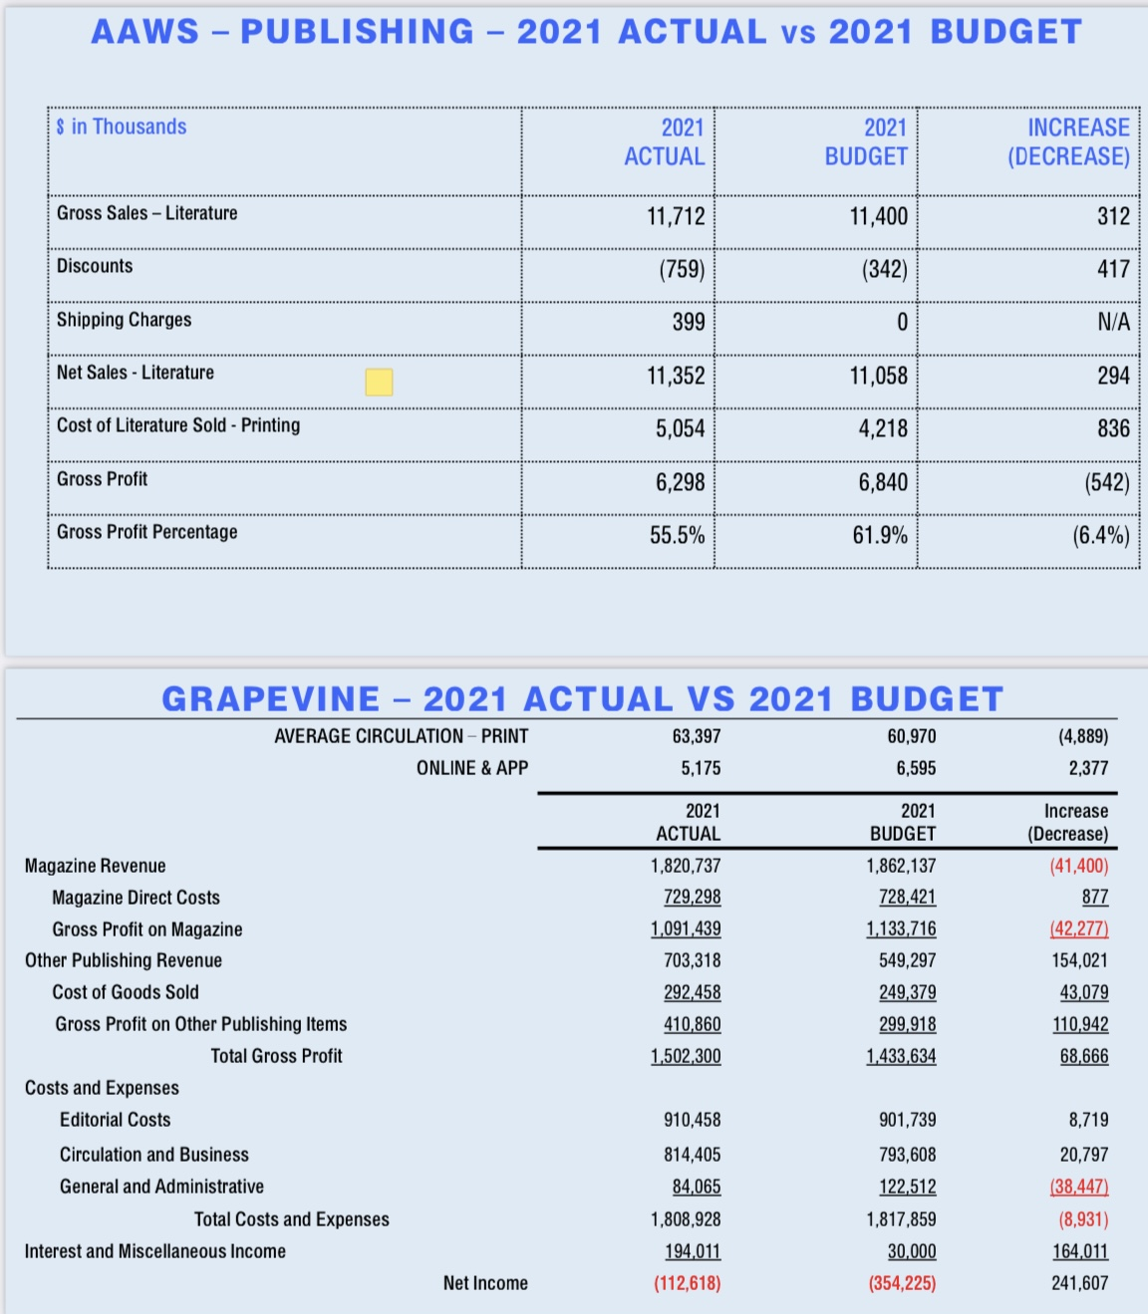

Slide 138
The 72nd Annual General Service Conference
Contributions
Contributions of $10.7 million in 2021 versus $10.3 million in 2020, $8.9 million in 2019 and $8.4 million in 2018 and 2017
45% of total contribution revenue was for contributions of $50 or less and two-thirds came from contributions of $100 or less. Only 4% of contributions revenue came from the “over $500 category”. Bottom Line – Larger contributions from areas and groups are the icing on the cake but the “cake” is smaller contributions from individuals and groups
Online contributions were 23% of the total in 2021 versus 3% in 2012

Slide 139
The 72nd Annual General Service Conference
Immense gratitude to the Fellowship for stepping up contributions during these uncertain times. This revenue does not however represent a bonanza – it is helping to offset the drop in publications gross profits (see next slide)
Self Support: Your 7th tradition dollars fulfilling our primary purpose:
Newly revised Service Manual
Meeting Guide App
Fellowship Connection
27 books uploaded to Jpay, available to those confined in correctional facilities
New Group form
Two new A.A. Public Service Announcements
New redesigned website

Slide 140
The 72nd Annual General Service Conference
Literature Sales
Gross Literature Sales have Fallen During the Pandemic while the gross profit on each item has dropped due to increased printing and mailing costs. Contribution growth has only partially offset these losses. Combined gross profit and contributions are running at least $1 million below 2019 levels.
Big Question – How much of drop in gross sales is due to factors other than the Pandemic that may or may not reverse? This question is why we allowed the budgeted deficit in 2022 – We assumed minimal rebound in the budget as we emerge from the Pandemic
Additional contributions are still needed.

Slide 141
The 72nd Annual General Service Conference
Reserve Fund
In 2020, the Reserve Fund was drawn down by $4 million dollars. The initial draw was due to the immediate cancellation of the international convention. Much of the convention loss was ultimately covered by insurance. However, by that time, literature sales dropped precipitously as outlined above. Contributions have offset part of this loss but net from 2019 we are still taking in less revenue.
Trustees Finance and the GSB are taking a cautious approach to the reserve fund:
A small transfer of $250,000 was made in 2021
A transfer in January 2022 was not made despite the 2021 surplus in light of the budgeted loss for GSO in 2022 (transition year)
Strong desire not to put more in the reserve than we can truly afford resulting in ill-timed budget changes or the need to withdraw from the fund in the near term
Based on the 2021 balance and the 2022 budgeted expenses the reserve fund 7.84 months of expenses are in reserve. The generally understood target range is 9 to 12 months.
Trustees Finance discusses all of these issues at every meeting

